Slide 1
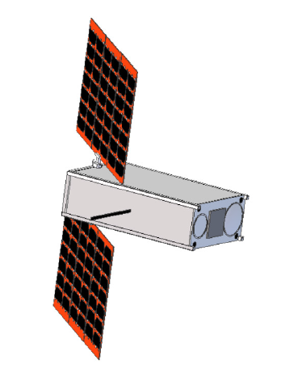
HEO-F Mission Overview
- Space System Design Concept -
November 19, 2014
ELaNa Reviews

Slide 2

HEO-F Mission Objectives
Demonstrate the Utility and Advantages of a HEO/GTO for CubeSat Technology.
Demonstrate that a CubeSat Can Perform a Significant Communications Application Mission
  100 Simultaneous Voice Users
  36,000 km Link
  24 GHz Downlink; 10.5 GHz Uplink
  1 meter Diameter User Ground Station Dish Antenna
  < $1000 User Terminal Cost (Terminal Development is a Program Element)
Measure Propagation Effects on the Lowest Frequency H₂O Absorption Line. (Vanderbilt University)
Measure the Radiation Environment of this GTO Orbit (Vanderbilt University)

Slide 3
HEO-F Mission Objectives (2)
Demonstrate the Ability of a PPT Propulsion System to Carry Out Critical Mission Functions:
  Perigee Raising a GTO
  Mission Termination
Demonstrate the Reliability of a PPT, Low Power, Electric Propulsions System, in CubeSat Technology Environment and in a Geostationary Transfer Orbit:
  To Raise the Perigee to approximately 500 km
  To Eliminate the Spacecraft From Orbit at EOL over a Brief Period of Time (< 1 week from final burn)
To Continue to Support AMSAT and ARRL STEM Education Objectives as Already in Progress with the ARISS and FOX Spacecraft Missions.

Slide 4
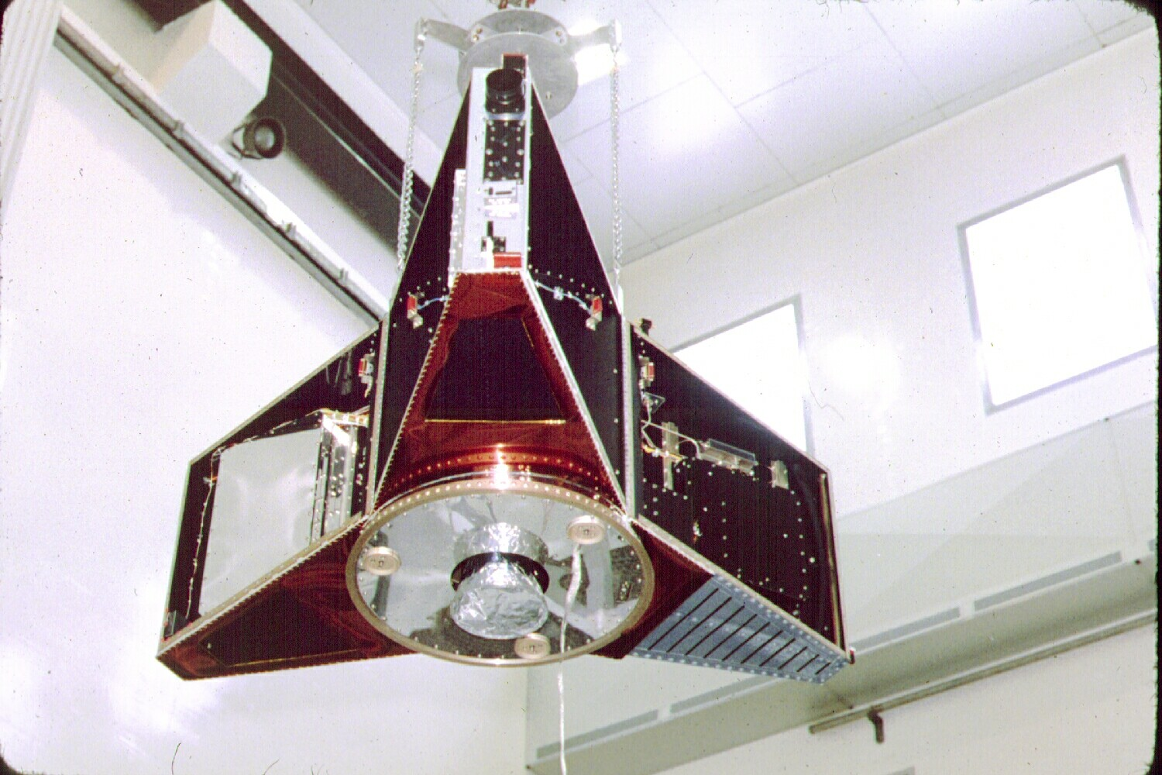
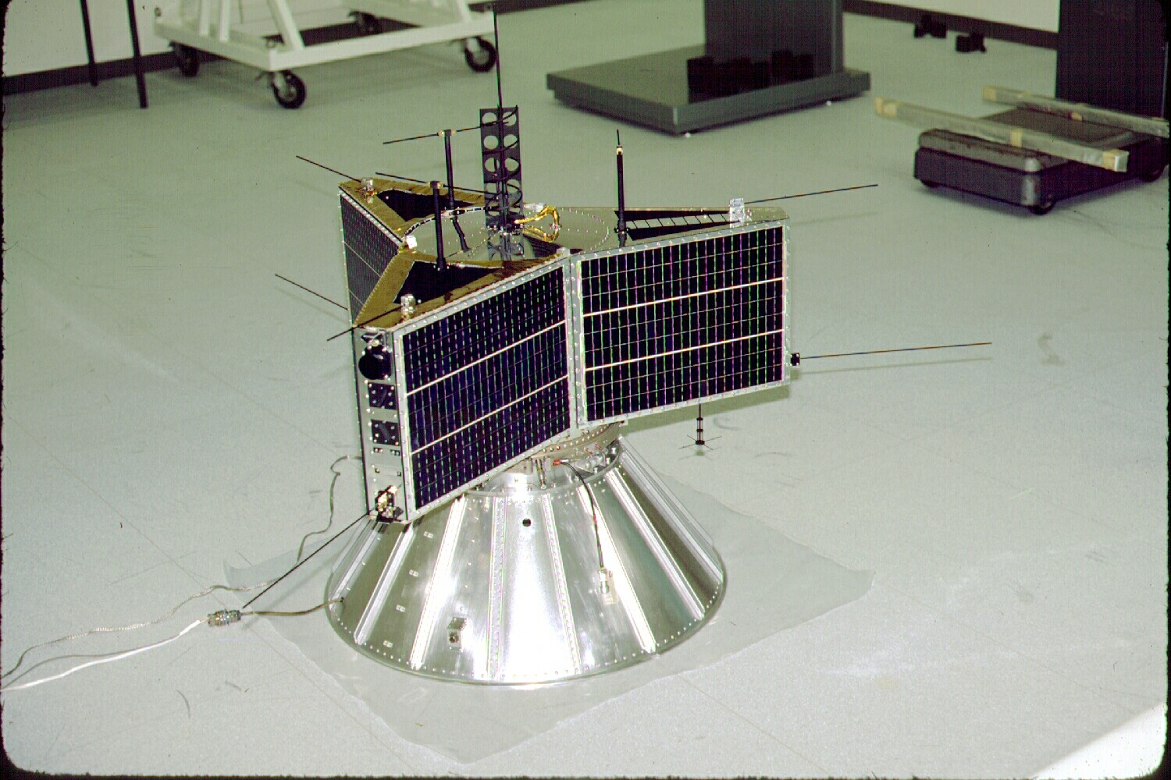
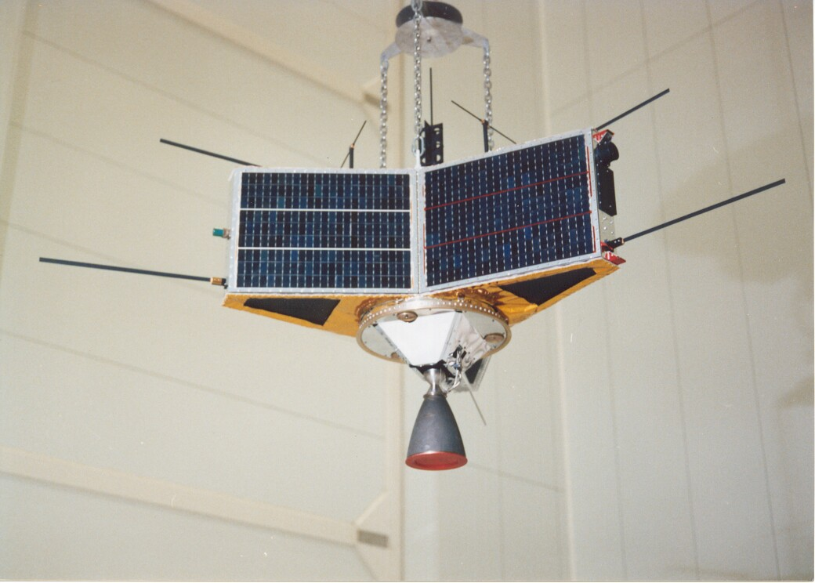
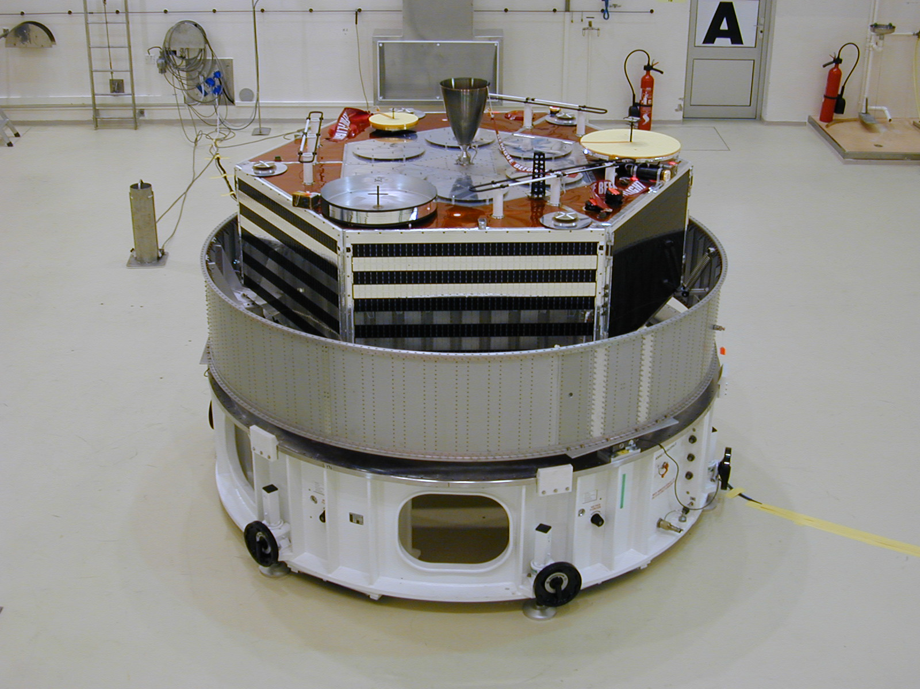
Prior AMSAT HEO
Missions
AMSAT-Phase-3A
(1980 – Launch
Vehicle Failure)
AMSAT-OSCAR-10
(1983)
AMSAT-OSCAR-13
(1988)
AMSAT-OSCAR -40
(November 2000)
AO-40 Took 1 Decade
To Construct and Launch

Slide 5
Mission Orbit(s)
Initial Orbit:
  ha = 35,786 km
  hp = 200 km
  i = 7.0° to 51°
  ω = 178°
Final Orbit:
  ha = 35,786 km
  hp = 500 km
  i = Unchanged
  ω = 180°
Removal Orbit:
ha = 35,786 km
hp = 80 km
i = Unchanged
  ω = unknown°
ΔV=31 m/sec
ΔV=
44 m/sec

Slide 6
Spacecraft Physical Size
6U Cubesat Form Factor (But, 3 Standards Exist)
Up to 12 Kg Mass
Dimensions are provided by Innovative Solutions in Space BV

Slide 7
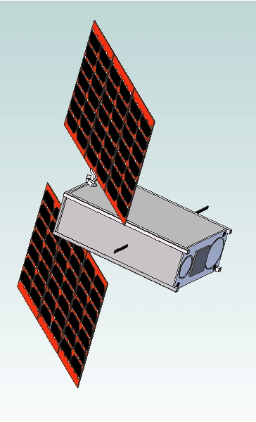
36-44 watt Light Weight Solar
Array; MMA Design, LLP
(typical of 2)
10.5 GHz Horn
(17.2 dBi Gain)
Solar Array
Drive
Mechanism
435 MHz
Omni
Antenna
Spacecraft
Configuration
1269 MHz
Omni
Antenna
1.270 GHz
Patch Antenna
24 GHz Horn
(20.0 dBi)

Slide 8
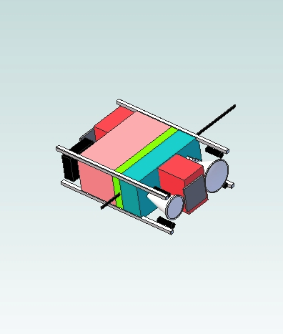
Spacecraft Internal
Volume Allocation
Vanderbilt Radiation Experiment
L/UHF Transponder +TLM +CMD
X-Ka (mmW) Transponder
Star Tracker
1269 MHz Monopole
Avionics (3 RWs, Flight Computer,
MPPTs, BCR, PDU)
μCAT PPT
(typ. of 4)

Slide 9
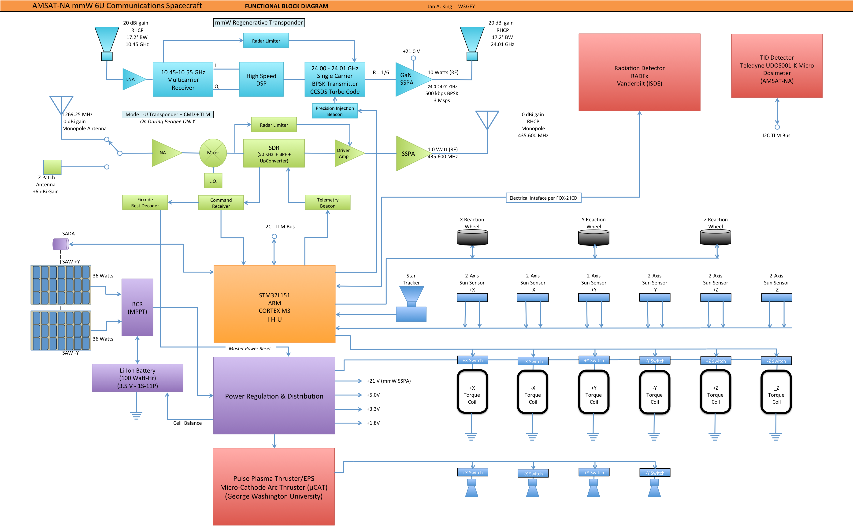
Spacecraft Functional Block Diagram

Slide 10
Power Subsystem
Solar Arrays: MMA E-HaWK design; 72 watts average; 86 watts peak BOL; MPPT
Batteries: Li-Ion; 2600 mAHr Each; 11P1S;
  Capacity: 109 Watt-Hrs (3.5 V x 2.6 AHr x 12 Cells)
  Driving Requirement is Worst Case Eclipse Heating (2 hour eclipse w. 10 watt heaters) = 20 watt-Hrs
  Worst Case DoD: 18.3%
mmW Transponder Not Powered During Eclipse
L/UHF Transponder Powered During Nominal Eclipses but, not during W.C. Eclipses.
Loads Individually Switched: 3.3V, 5.0 V and 20 V (GaN SSPA)

Slide 11
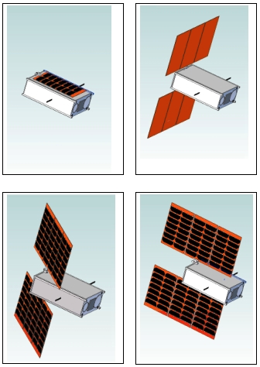
SOLAR
ARRAY
WINGS
(SAWs)
&
SADA
Solar Array Wings
(SAWs) – Two
MMA E-HaWK
Triple Deployment
Fits in 8.5 mm Stack
Peak Power: 86 W
Avg. Power: 72 W
TRL Level 9 by Flight
Single Axis SADA
Full 360° Control

Slide 12
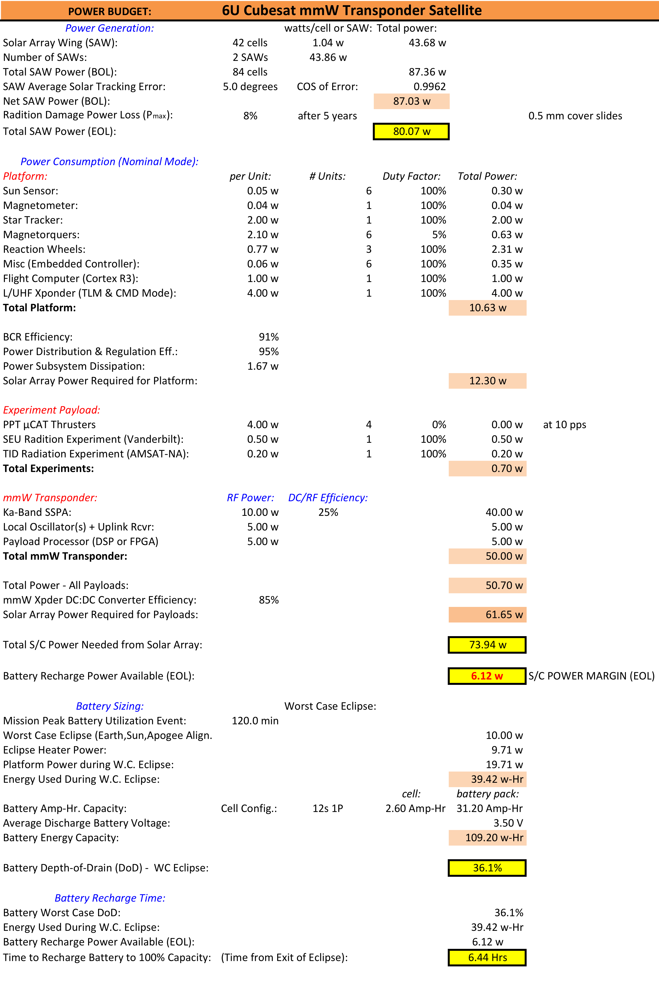
Power
Budget

Slide 13
Structure Design
(Basic Approach)
6U System is Volume Limited; Not Mass Limited
Rigid (Thick) Exterior Wall Construction
  Machined Exterior Walls (6mm to 8 mm thick); 6061-T6
  P-POD Rails Formed by E-HaWK Solar Panel Exterior Frame
  Machined “Boss” Wall-to-Wall Interfaces; Screwed Joints
Avionics Module Span Interior Volume between Walls adding Significant Additional Stiffness.
Recent Vibration Testing on a Similar 6U demostrated a First Mode Resonant Frequency >1000 Hz

Slide 14
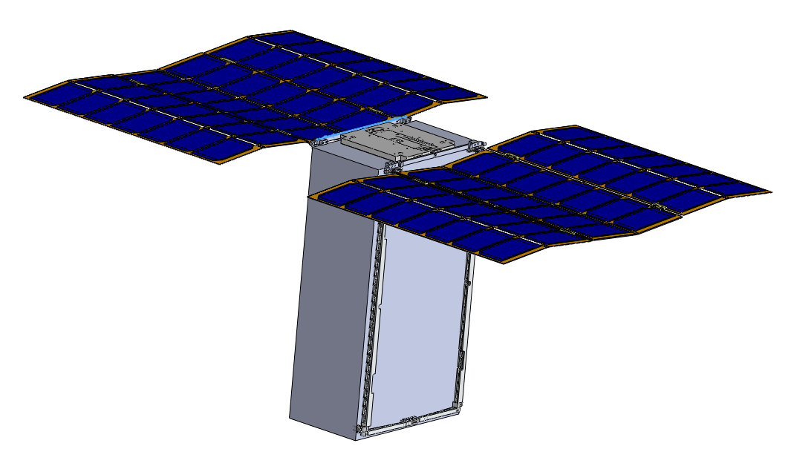
Structure Design (2)
P-POD Guide rails are formed
by the mechanical frame which
also holds and secures the
folded SAWs. Arrays fold
within an 8.5 mm packing
height.
TWO FOR THE PRICE
OF ONE FRAME.
3D CAD Courtesy MMA Design, LLC

Slide 15
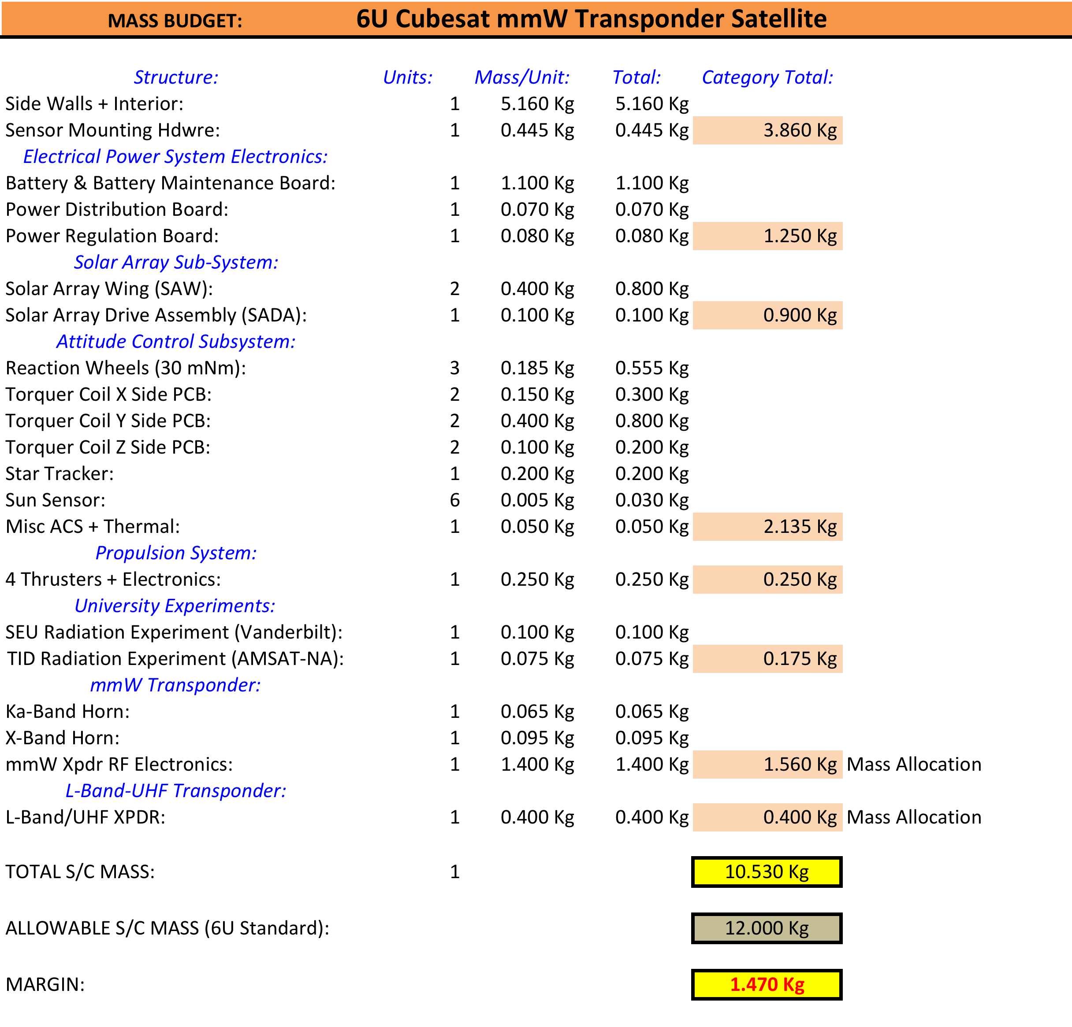
Mass
Budget

Slide 16
Thermal Design

Slide 17
Attitude Control System
3-Axis Attitude Control System
Requirements:
  Accuracy & Knowledge:
    P: ± 1.0° (driven by Ka-Band antenna beam)
    R: ± 1.0° (driven by Ka-Band antenna beam)
    Y: ± 5.0° (driven by Solar Array Drive requirements
  NADIR Pointing Mode (with varying Earth size): ± 1.0°
  Safe Hold Mode: Return SADA to 0°; Spin about Y; Sun in XY Plane
  Point-on-Earth Target Tracking Mode (Optional)
  Maintain Solar Array Axis (Y) Normal to Sun at all Times
  Control SADA to Maintain Cells Normal to Sun (Full Power)
  Momentum Dumping Scheme at Perigee

Slide 18
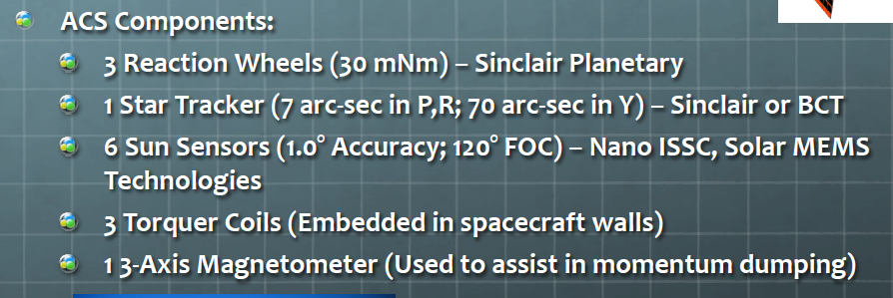
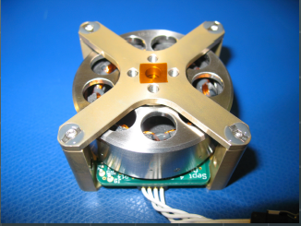
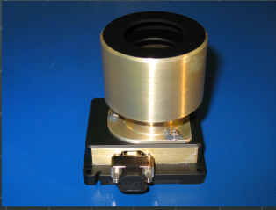
Attitude Control System (2)
Sinclair
RW
Sinclair
Star Tracker

Slide 19
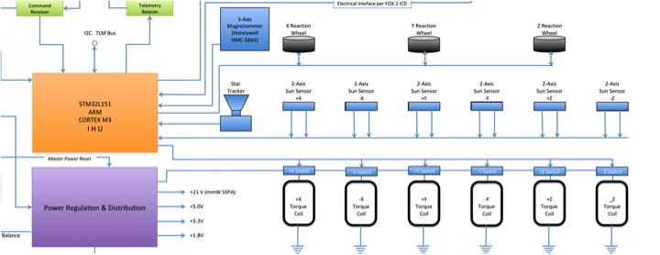
Attitude Control System (3)
(Component Interfaces)

Slide 20
Attitude Control System (4)
(Operating Modes)
Set SADA = 0°; Spin about Y; Sun in XZ Plane
Safe-Hold
Mode
De-Tumble
Mode
NADIR Pointing
Mode
Commanded Earth Target ±1°
Earth Target Tracking
Mode
Propulsion
Mode
Earth Center ±1°
At Apogee; Ram or Wake ±1°
(Optional)
November 13, 2014
HEO-F Overview
21

Slide 21
Flight Computer (IHU)
(Has Flight Heritage from FOX Program)
STMicroelectronics STM32L151VBT6
ARM3 Cortex CPU (32-bit)
Up to 33 MIPS @32 MHz
Designed for ultra low power consumption
128K FLASH program memory
16K RAM (Will Likely Need More RAM)
Built-in timers, RTC, D/A, A/D, serial IO

Slide 22
Primary Experiment
- mmW Regenerative Transponder -
10.45-10.50 GHz Amateur Band Currently Actively In Use – Makes a Good Uplink Band. Many Transmitters are Available.
24.00-24.05 GHz Amateur Band not Used Very Much – Will Make a Good Downlink Band
But, 24 GHz is nearly ON the first Water Absorption Line.
This makes transmitting on this frequency much more interesting as it allows us to “see” weather with our transponder.

Slide 23
Primary Experiment
mmW Regenerative Transponder (2)
Horn Beamwdith ≈ Earth Coverage
10.5 GHz Horn (17 dBi)
24 GHz Horn (20 dBi)
10.45-10.50 GHz
Multicarrier
RX
High Speed
ADCs
Fast DSP
Of
FPGA
Single Carrier
BPSK 24 GHz TX
+ Turbo Code Encoder
Uplink:
100 Users; Contention Based FDMA
Users Select Frequency Radomly
Conflicted Users Retry on Random Freq.
User TX is 2.0 watts
User Antenna is 1 meter dish
FEC on Uplink: R=1/2 Sequetial + RS
Spectral Efficiency ≈ 0.5 bit/Hz
User Rate = 5000 bps = 10 kHz
Uplink RX FFT Used to Find Each User within ms, capable of 100 sequential acquisitions..
Downlink: 10 W GaN 24 GHz SSPA
Uplink data streams aggregated into
a single downlink bit stream.
100 Users x 5,000 bps = 0.5 Mbps D.R.
Downlink Heavily Coded: R=1/6 Turbocode
Modulation is surpressed carrier BPSK
Simbol Rate = 3Msps
Bandwidth approximately 7.5 MHz
Each User Can Decode Any 5 kbps
Bit Stream
Primary User Interface is Codec-2 Vocoder

Slide 24
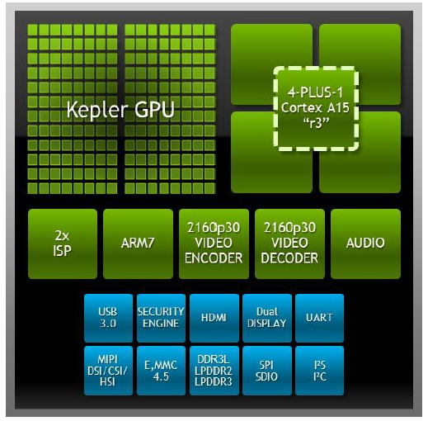
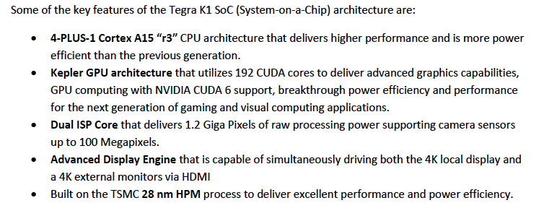
Primary Experiment mmW Regenerative Transponder (3)
Uplink Signal Processor
(How Do We Know It Can Be Done?)
NVIDIA Tegra K1 GPU

Slide 25
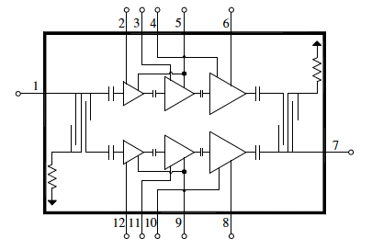
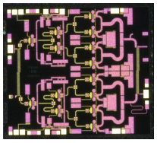
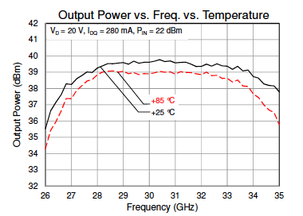
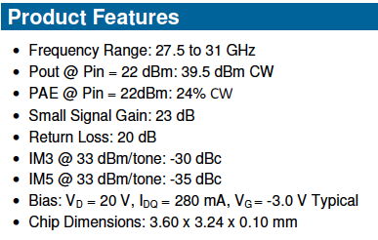
Primary Experiment mmW Regenerative Transponder (4)
24 GHz GaN SSPA
(How Do We Know It Can Be Done?)
27.5 - 31 GHz 9W Power Amplifier
TRIQUINT
Part # TGA2595

Slide 26
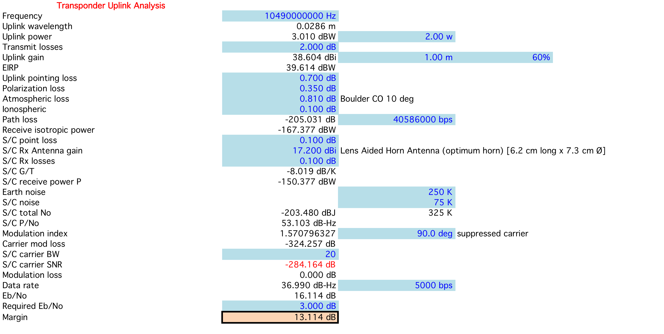
mmW Transponder
Uplink (Reference)
Ref: Boulder, CO @ 10° Elev. Angle; Clouds, No Rain

Slide 27
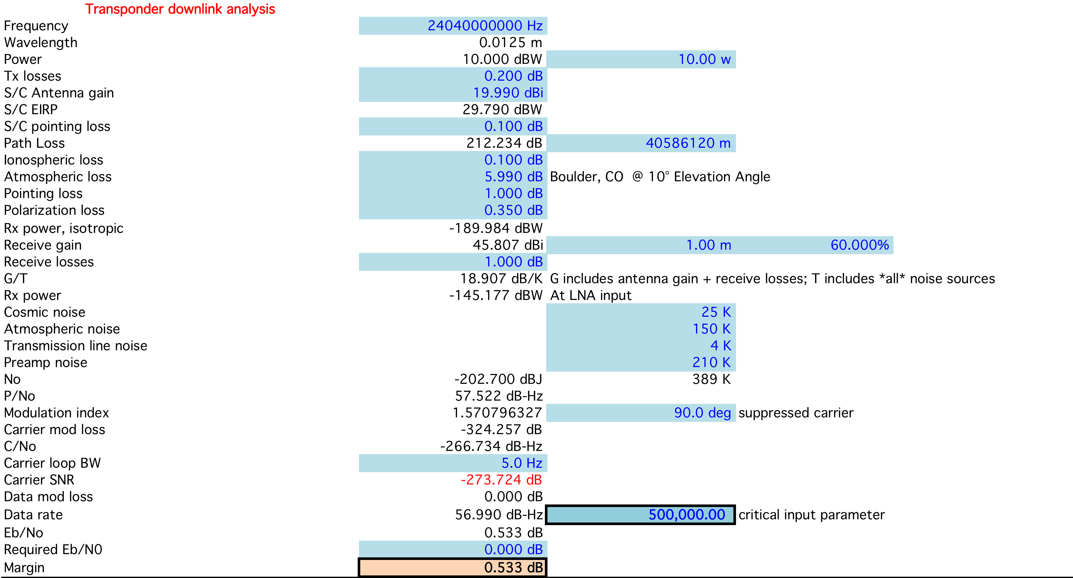
mmW Transponder
Downlink (Reference)
Ref: Boulder, CO @ 10° Elev. Angle; Clouds, No Rain
100 Users @ 5.0 kbps each

Slide 28
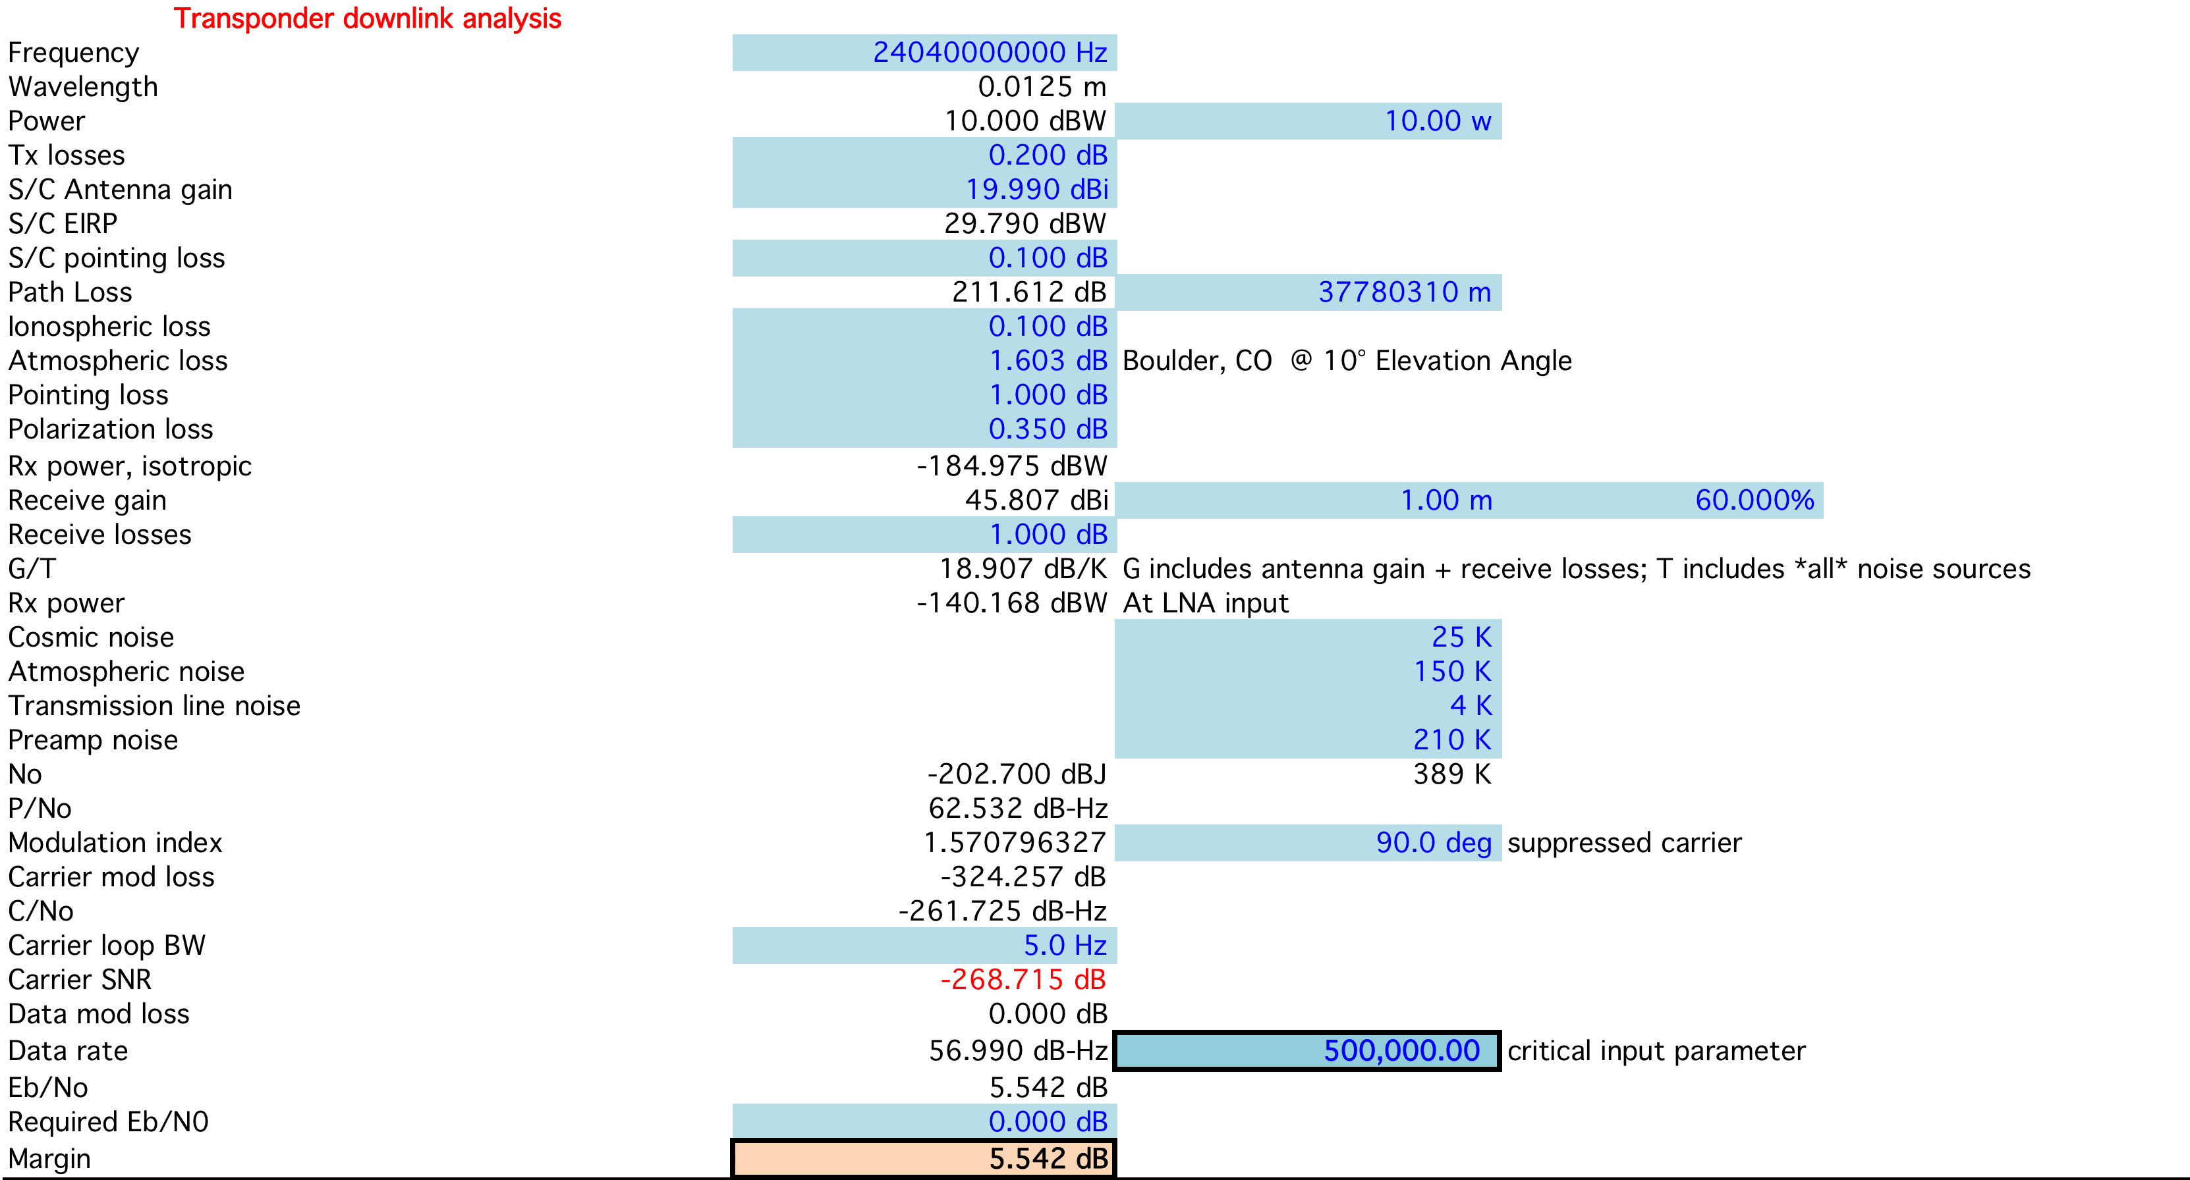
mmW Transponder
Downlink (Typical Conditions)
Ref: Boulder, CO @ 40° Elev. Angle; Clouds, No Rain
100 Users @ 5.0 kbps each

Slide 29
T & C; L-to-U Transponder
UHF Telemetry Downlink (On XPDR Subcarrier)
9600 BPSK (Carrier Surpressed)
Required TLM G.S. Gain: 17.1 dBi (e.g. Standard Yagi Antenna)
L-band Command Uplink (On Uplink Sub-band)
Required Uplink Power for CMD: 25 watts
Required CMD G.S. Antenna Gain: 17.1 dBi (e.g. one M² Yagi)
Link Margin at Apogee: >6 dB both directions
R=1/2 Sequncial (e.g. Viterbi ) + Block Code (e.g., RS) Used [Both Links]

Slide 30
L-Band to UHF Transponder
  Active Below 5000 Km Altitude (Thru Perigee Typical)
  Monopole on TX (shared with TLM subcarrier)
  Uplink (Patch for NADIR Use and Monople Otherwise)
  T&C Active at All Times
  UHF SSPA: ≥ 1.0 watts
  L-Band LNA: ≤ 1.0 dB NF (75 K) 225K system N.T.
  User Passband: 40 to 50 KHz
T & C; L-to-U Transponder
TLM Subcarrier at -10dB while XPDR is on
Beacon
Transponder Passband

Slide 31
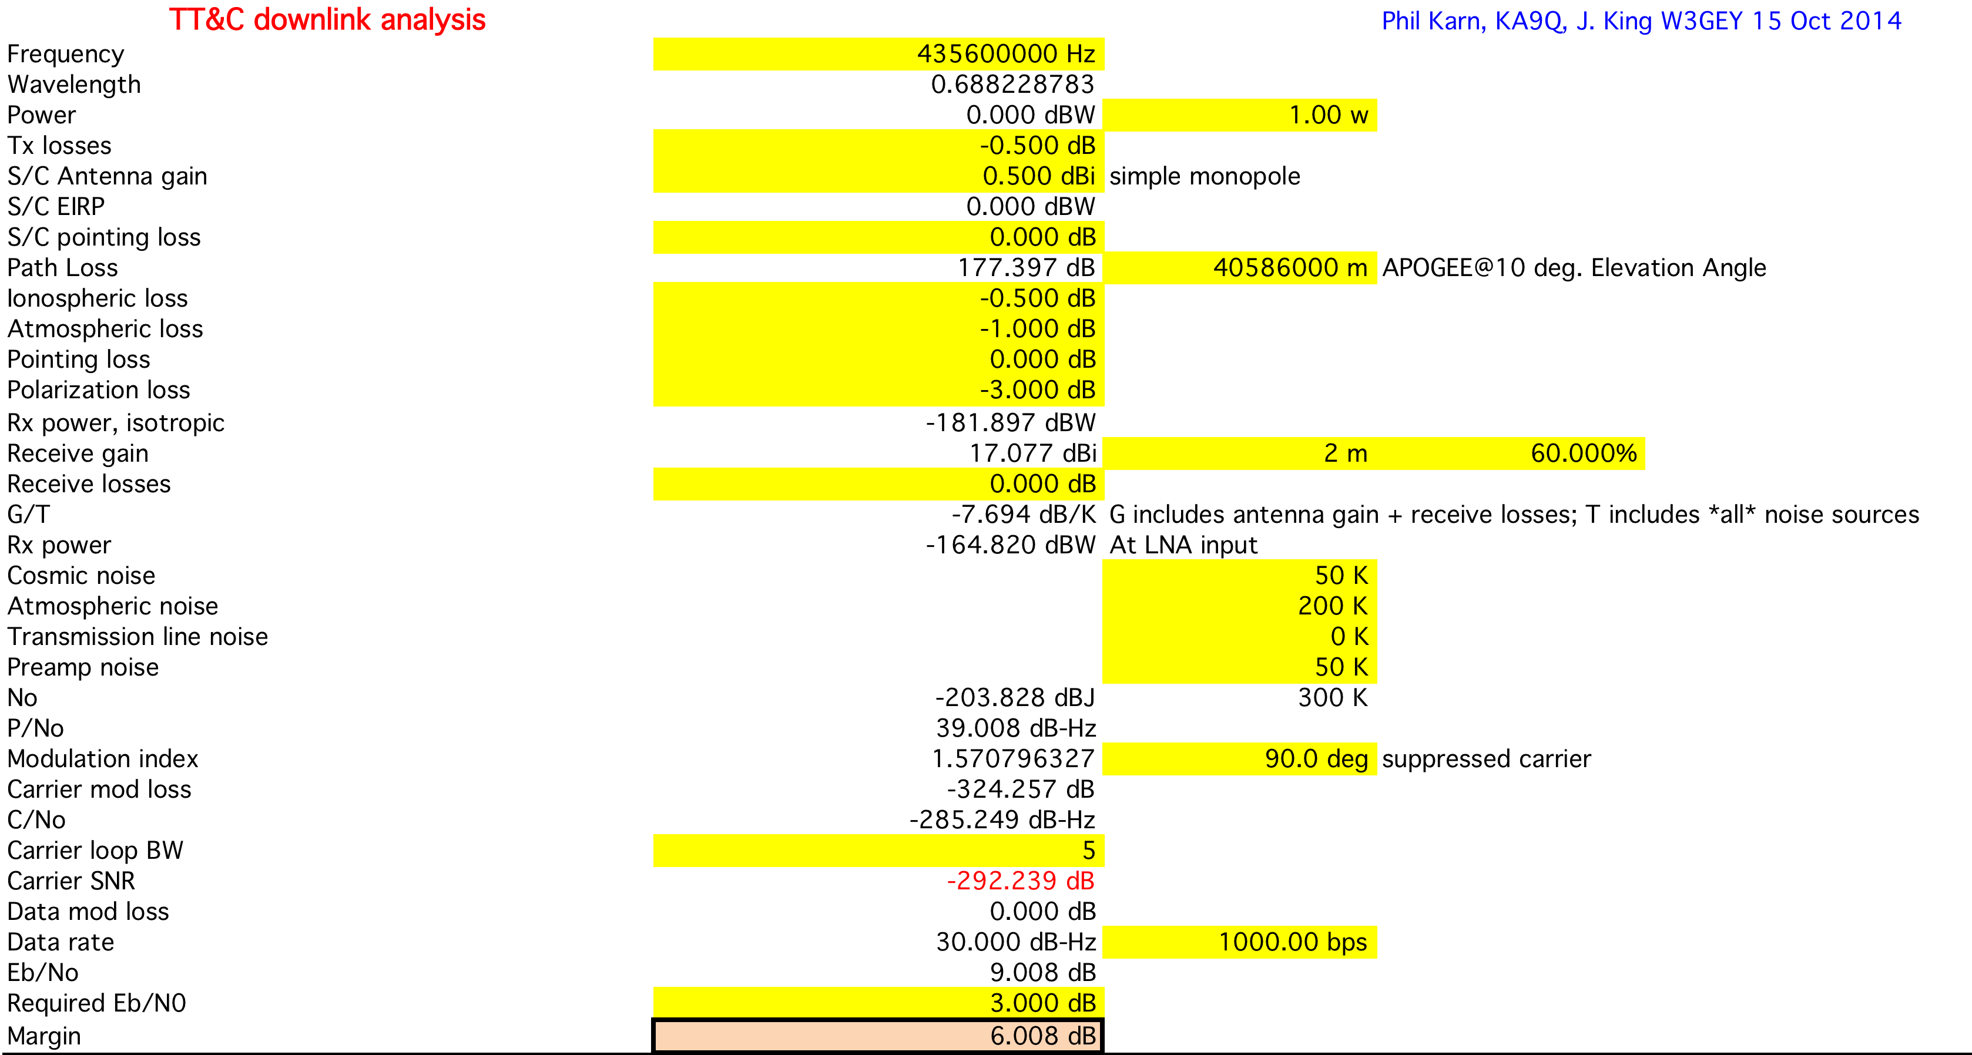
TLM Link Budget
(@Apogee; Elevgle = 10°)
Circularly Polarized Yagi
C

Slide 32
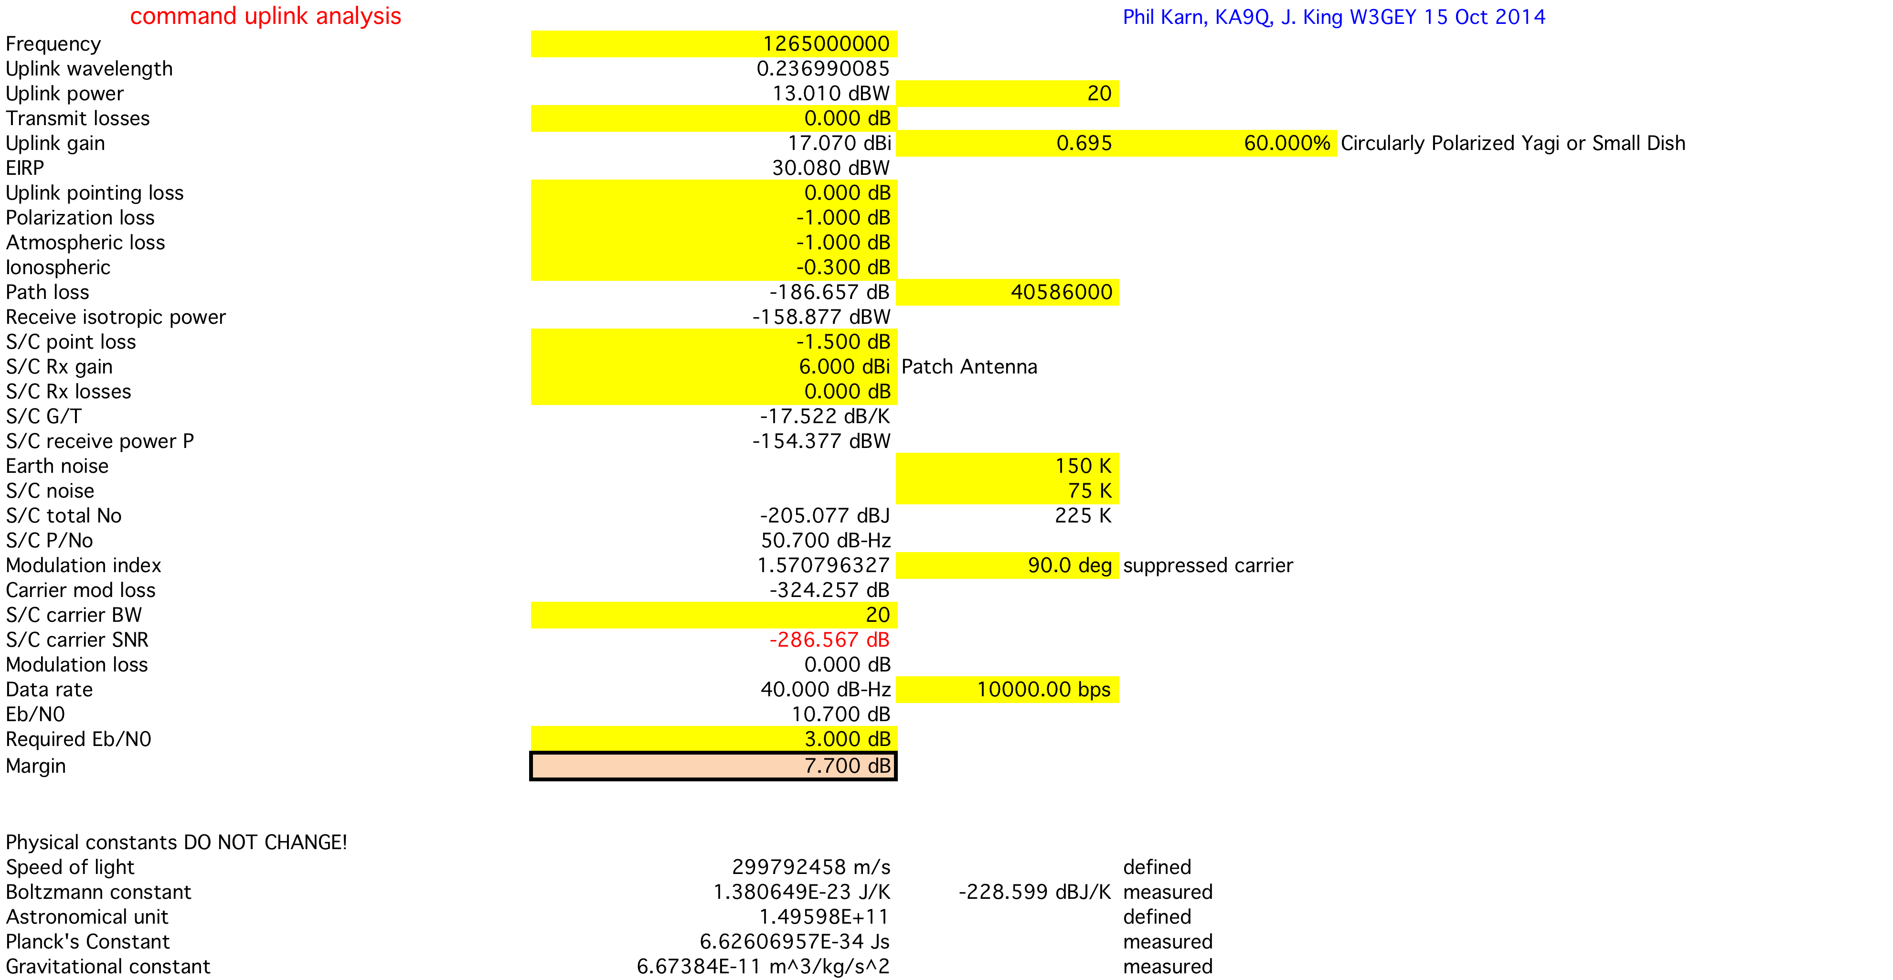
CMD Link Budget
(@Apogee; Elevgle = 10°)
C

Slide 33
RadFx Experiment
Vanderbilt University
Vanderbilt researchers are investigating the SEU sensitivity of carefully selected digital devices.
Models developed will allow estimates of the cross sectional area of a single device cell for protons capable of generating SEUs.
SEUs will be evaluated as a function of supply (bias) voltage and orbit radiation inputs.
The RadFx unit is a copy of that being flown in 2015 on the Fox-1 Cubesat.
The radiation environment, however for GTO is quite different. (See Feasibility Rev.)
Figure 5. Simulated and experimental proton cross sections
of a 65 nm SRAM cell. Model provides good agreement at high
energy and captures the steep increase in cross section at low energy.

Slide 34
Precipitation Attenuation Experiment
Vanderbilt, Department of Atmospherics
Experiment will Measure the Attenuation of a Special Beacon provided by the mmW Transponder on its Downlink Path. Careful Calibration of Amplitude and Phase Noise measurements will be made of this beacon prior to launch.
The power level of the beacon will be adjustable by ground command (from a level of +3o dBm to 0 dBm) Amplitude level will be measured, recorded, time-tagged by the IHU for subsequent TLM downlink.

Slide 35
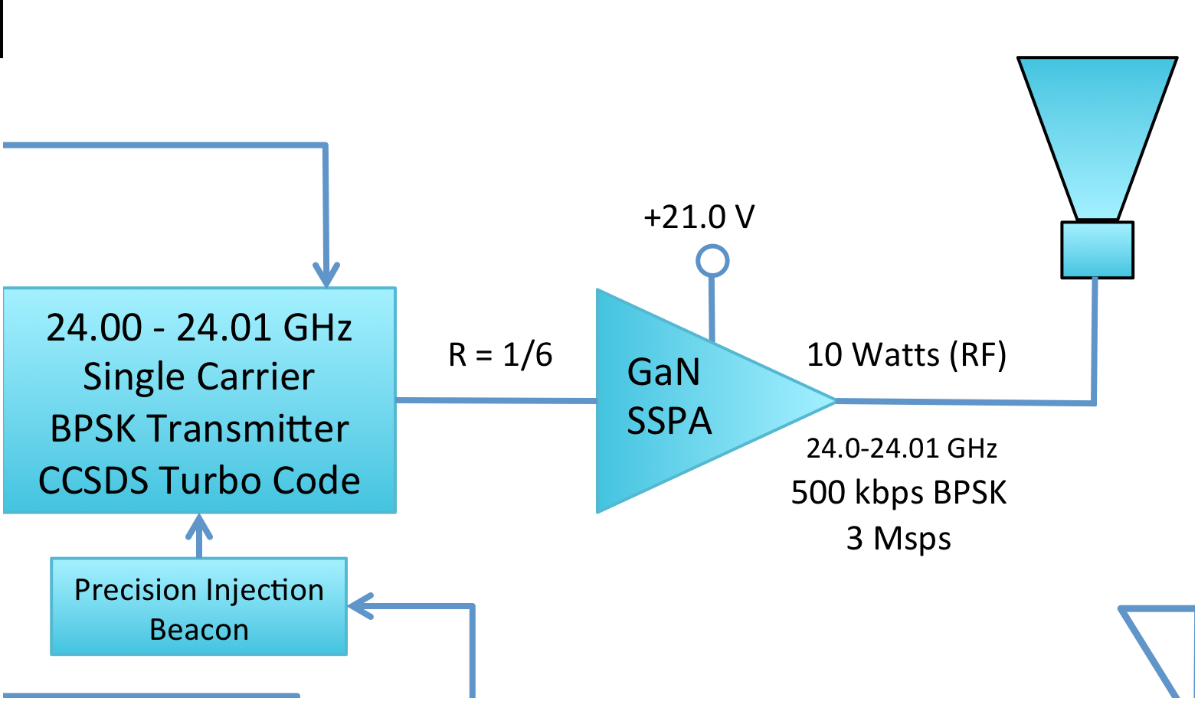
Precipitation Attenuation Experiment
IHU Beacon Control
Precision Injection
Beacon
Transponder Downlink
Modulation Limit (10 MHz)
22.800 – 24.000 GHz
(TBD)
24.001 GHz
24.01 GHz

Slide 36
Pulse Plasma Thruster (μCAT )
George Washington University, Wash. DC
Micro-Cathode Arc Thruster (µCAT) micro-propulsion subsystem is an outgrowth of GWU Micropropulsion and Nanotechnology Laboratory (MpNL) research.
The technology here will be used in two mission-critical phases
  Perigee raising or maintenance
  Mission Termintation (By lowering perigee at EOL)
Total ΔV Requirement is approximately 75 m/sec
  31 m/sec for perigee raising
  44 m/sec (or less) for mission termination
Four Thrusters will be employed in Off-Pulse mode to control attitude during the active maneuver.

Slide 37
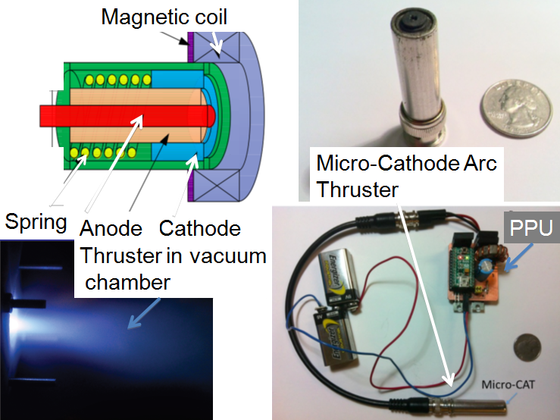
Pulse Plasma Thruster
(μCAT)
Typical of 4 Units

Slide 38
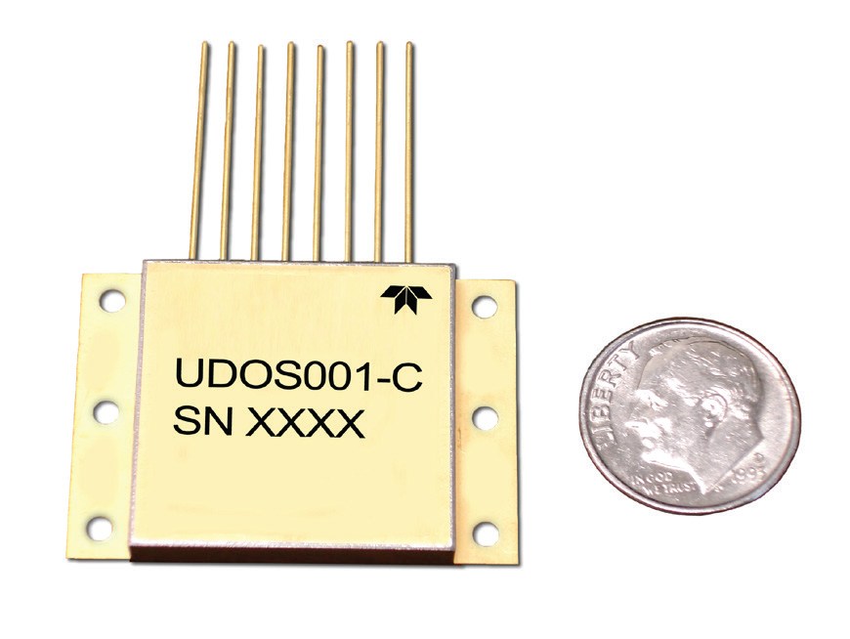
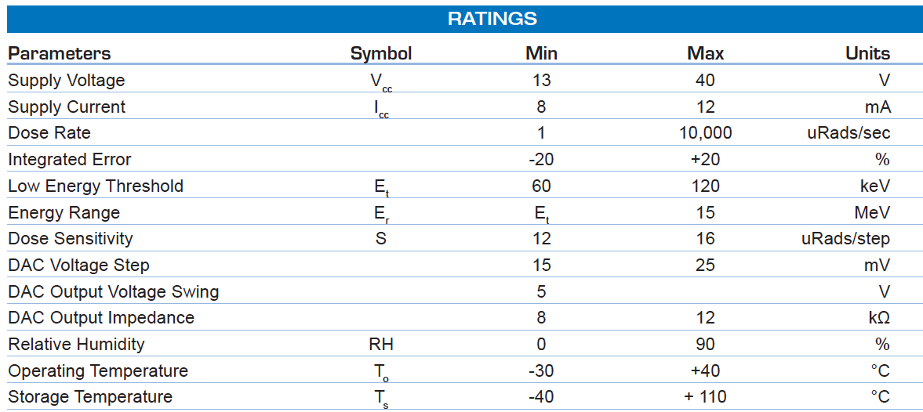
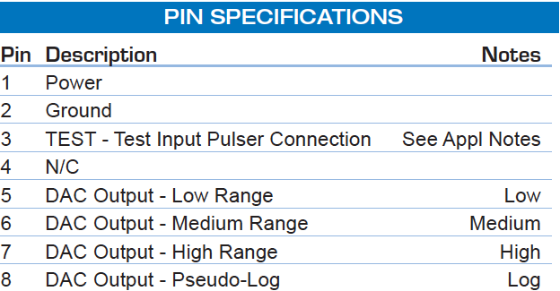
Total Integrated Dose (TID)
Radiation Monitor (AMSAT-NA)
Teledyne TID device will be flown to continuously monitor the in-flight cumulative dose.
Unit selected has a wide range of dose-rate settings.
Interface to S/C via A/D and I²C Telemetry Bus. Simple analog output.

