Slide 1
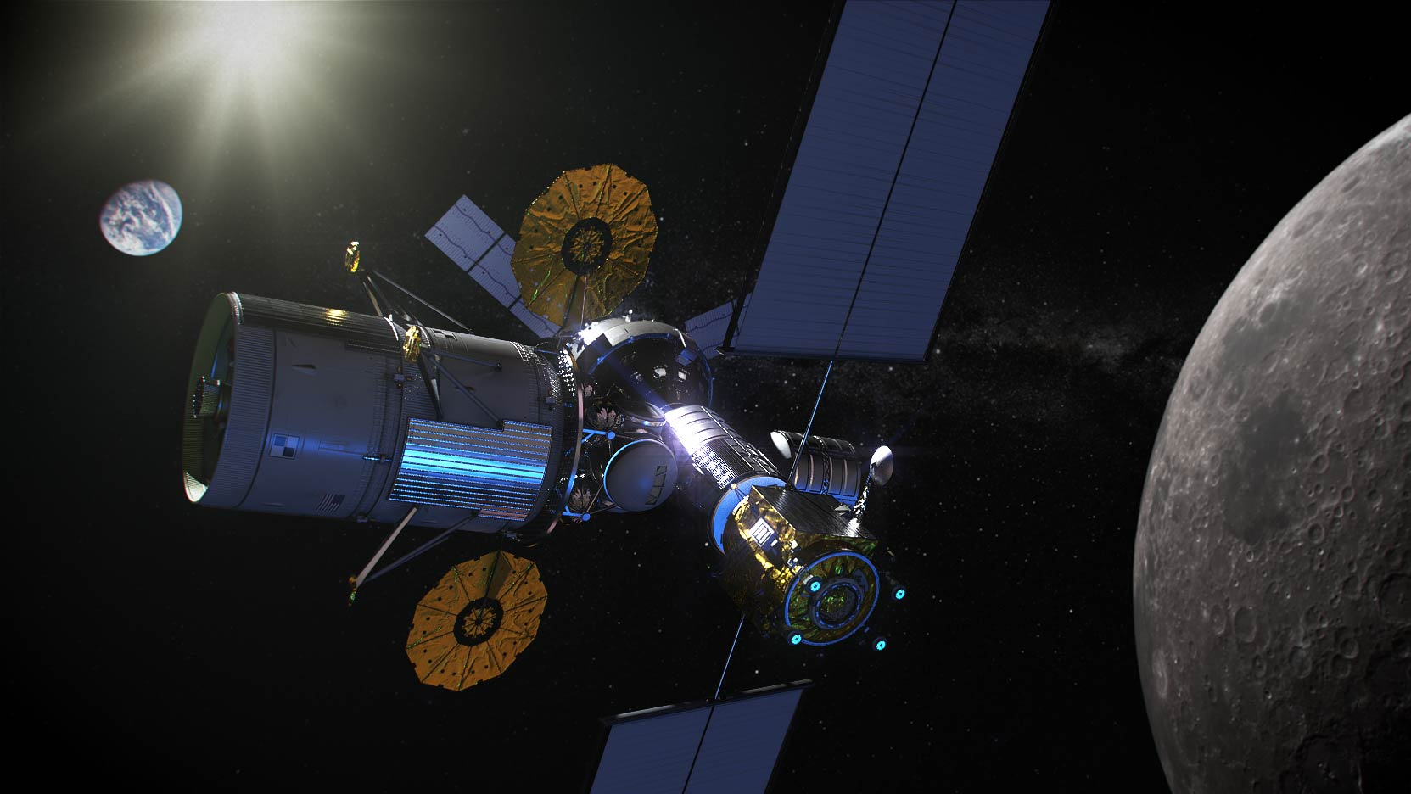


Gateway
Amateur Radio Exploration (AREx)
Enabling STEAM Inspiration, Engagement & Experimentation Through Direct Interaction with the Gateway AREx Payload
AMSAT
Systems Development Meeting
June 25, 2020
Updated July 2, 2020

Slide 2
Agenda
AREx Payload Systems (1 Hour)
    Programmatic and Technical
Requirements (45 minutes
Concept of Operations (ConOps) (45 minutes)
Risk identification, Risk Analysis (45 minutes)
Wrapup, Forward Work, Splinter schedule (30 min)

Slide 3
Meeting Objectives
This will be a “roll up your sleeves” working meeting
As a team we will:
Walk through the draft products (systems baseline products)
Critique these for completeness and accuracy
Make sure we are all on the same page on the systems baseline, concept of operations, requirements, risks
Develop a plan to move these drafty products into something that is mature enough to successfully pass a Mission Concept/Systems Requirements Review in August 2020
Until Today, All our meetings have been about 1 hour or less. Today we can more completely understand the AREx systems and evolve them…for the better

Slide 4
Homework Assignment
What should we call the Mark 1 radio system? I don’t think we want to call it the AREx radio system. How about some cute or catchy acronym? Lunar Explorer? Other ideas? Think about it. I would appreciate your thoughts on this matter.

Slide 5
Proposed AREx Payload Acronyms
Lunar Amateur Radio: Inspiration, Engagement & Education (LAUR:IE²)
Lunar Amateur Radio Exploration (LAREx)
Lunar Amateur Radio System (LARS)
Exploration via Amateur Radio for Lunar (EARL)
Lunar Amateur Radio Generational Explorer (LARGE)
Amateur Radio on the Lunar Orbiting Platform-Gateway (ARLOP-G)
Lunar Exploration via Amateur Radio (LExAR)
LUnar eXploration via Amateur Radio (LUXAR)
Lunar Exploration via Amateur Radio (LEAR)
Lunar Education via Amateur Radio Networking--Experiences (LEARNing Experiences)
Transceiver Without An Interesting Name (TWAIN)
Springboard

Slide 6
Alternative Payload Name: Lunar Deities
Artemis (Greek)
Diana (Roman)
Kuu (Finnish)
Luna (Roman)
Phoebe (Greek)
Selene (Greek)

Slide 7
AREx Payload
Systems

Slide 8
AREx Payload Systems
Agenda
Systems overview—Frank
Link Budget, Orbit/Attitude/Signal Availability—Chris, Achim, Ken E.
Mechanical—Tom S, Chris
Electrical (Power, SDR/RF systems, TTNC, Software,
Antenna system)—Lou, Michelle, Chris, Doug
Thermal—Tom S.
Ground station--Michelle

Slide 9
Short Quiz
Q: STEAM Education in Deep Space using Amateur Radio Infrastructure: Is this feasible?
Weak signal, long path length challenges are achievable and have been previously demonstrated by ARISS/AMSAT team
  Weak signal reception is an amateur radio operator challenge
  AMSAT satellites demonstrated GPS weak signal reception beyond geostationary orbit; NASA now using GPS half-way to the moon
  AMSAT/ARISS team tracked & received data from Voyager, Cassini, Venus Radar and several Lunar missions
  Chinese Radio Amateurs recently operated LongJiang 1 & 2 around the moon
  Prize for the first human amateur radio contact between the Earth and Mars
A: YES!
Notes:
Paper shows some of the details on how we are able make sure we have simple ground stations on Earth→easier contacts with the Lunar Gateway. By using microwave frequencies, we eliminate the weak signal (lunar long distance) issue. Also antenna pointing to the moon is super simple as compared to pointing to ISS. (moon—half day visibility; ISS 10 minute visibility).

Slide 10

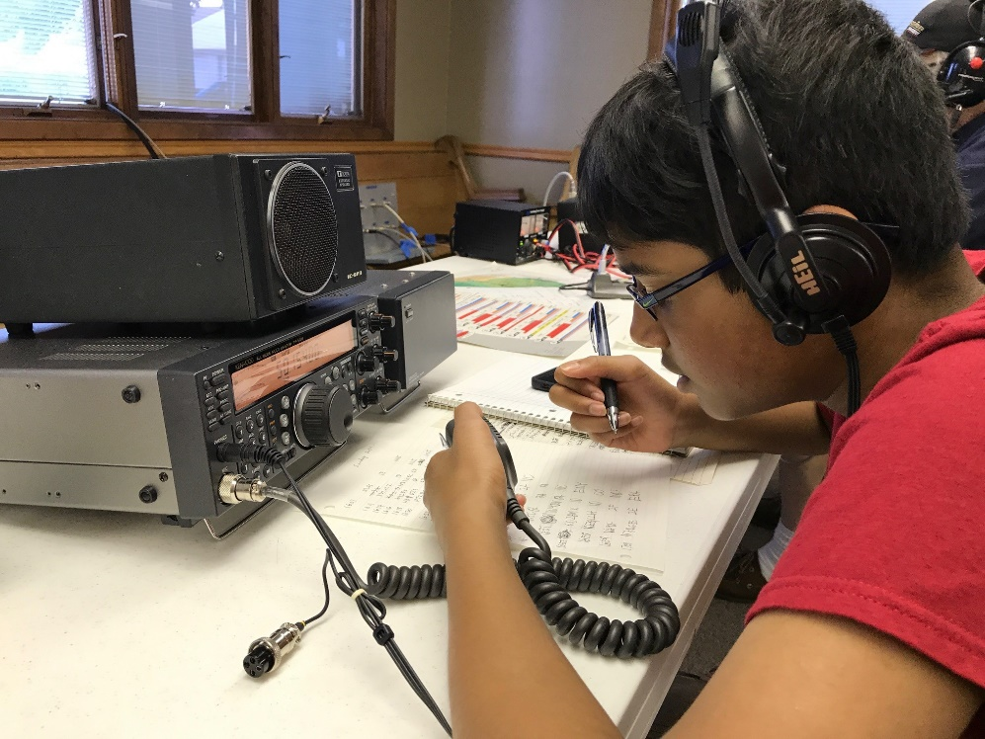
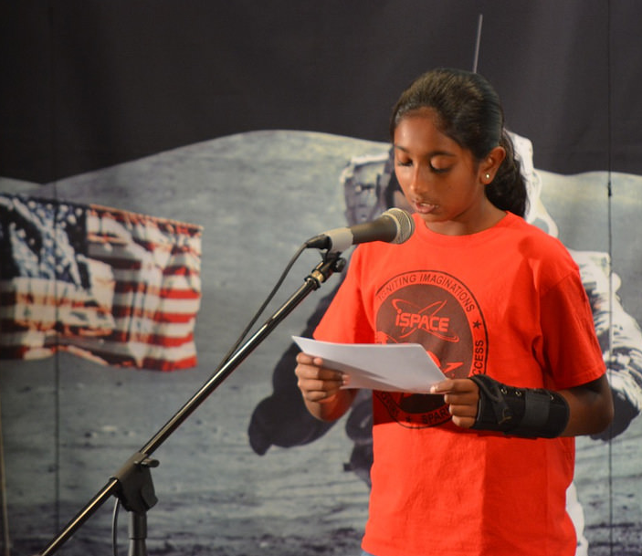
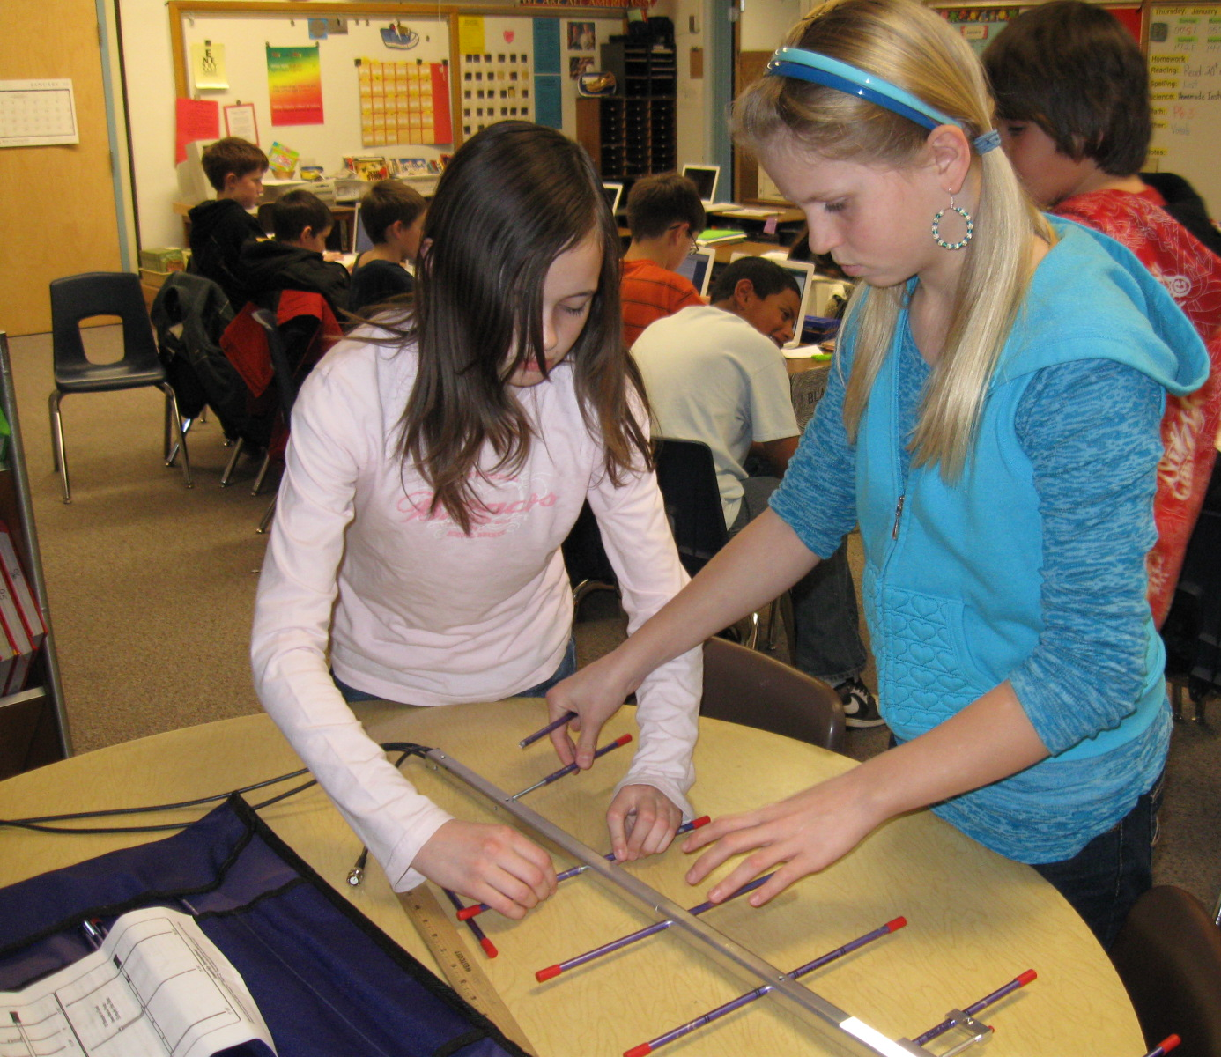
Transforming STEAM Education & Exploration from
Low Earth Orbit (ISS) To Cislunar (Gateway):
Amateur Radio Exploration (AREx)
Overview:
Hands-on engagement, validated by ARISS, enables students (and communities) to be immersed in the wonderment of space exploration
10 min ISS pass transformed into 12 hour hemisphere comm opportunities (voice, lunar/Earth pictures, Television, experiment data, Twitter-like messages, telerobot command between schools, etc)
Leverages ARISS international support, expertise and capabilities (hardware, operations and educational infrastructure) demonstrated on ISS
Coupled with AMSAT international’s deep space satellite development and operations expertise
Hardware development performed at no cost to space agencies; request launch and integration support
ARISS development, operations, education and student mentoring is performed by world-wide network of amateur radio & educator volunteers

Slide 11
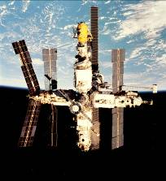
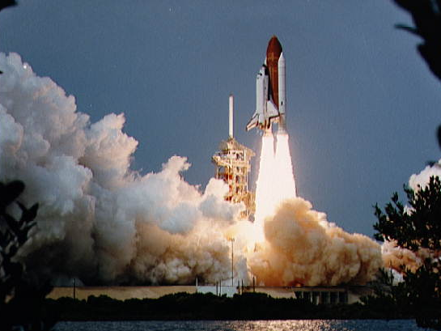
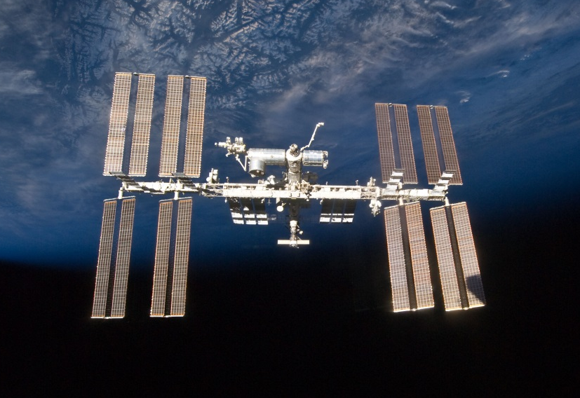
Amateur Radio On Human Spaceflight Missions
Since 1983, international amateur radio organizations have worked with the space agencies to fly amateur radio and to support educational initiatives on:
ISS
(ARISS)
Space Shuttle
(SAREX)
Mir
(Mirex/SAREX)

Slide 12
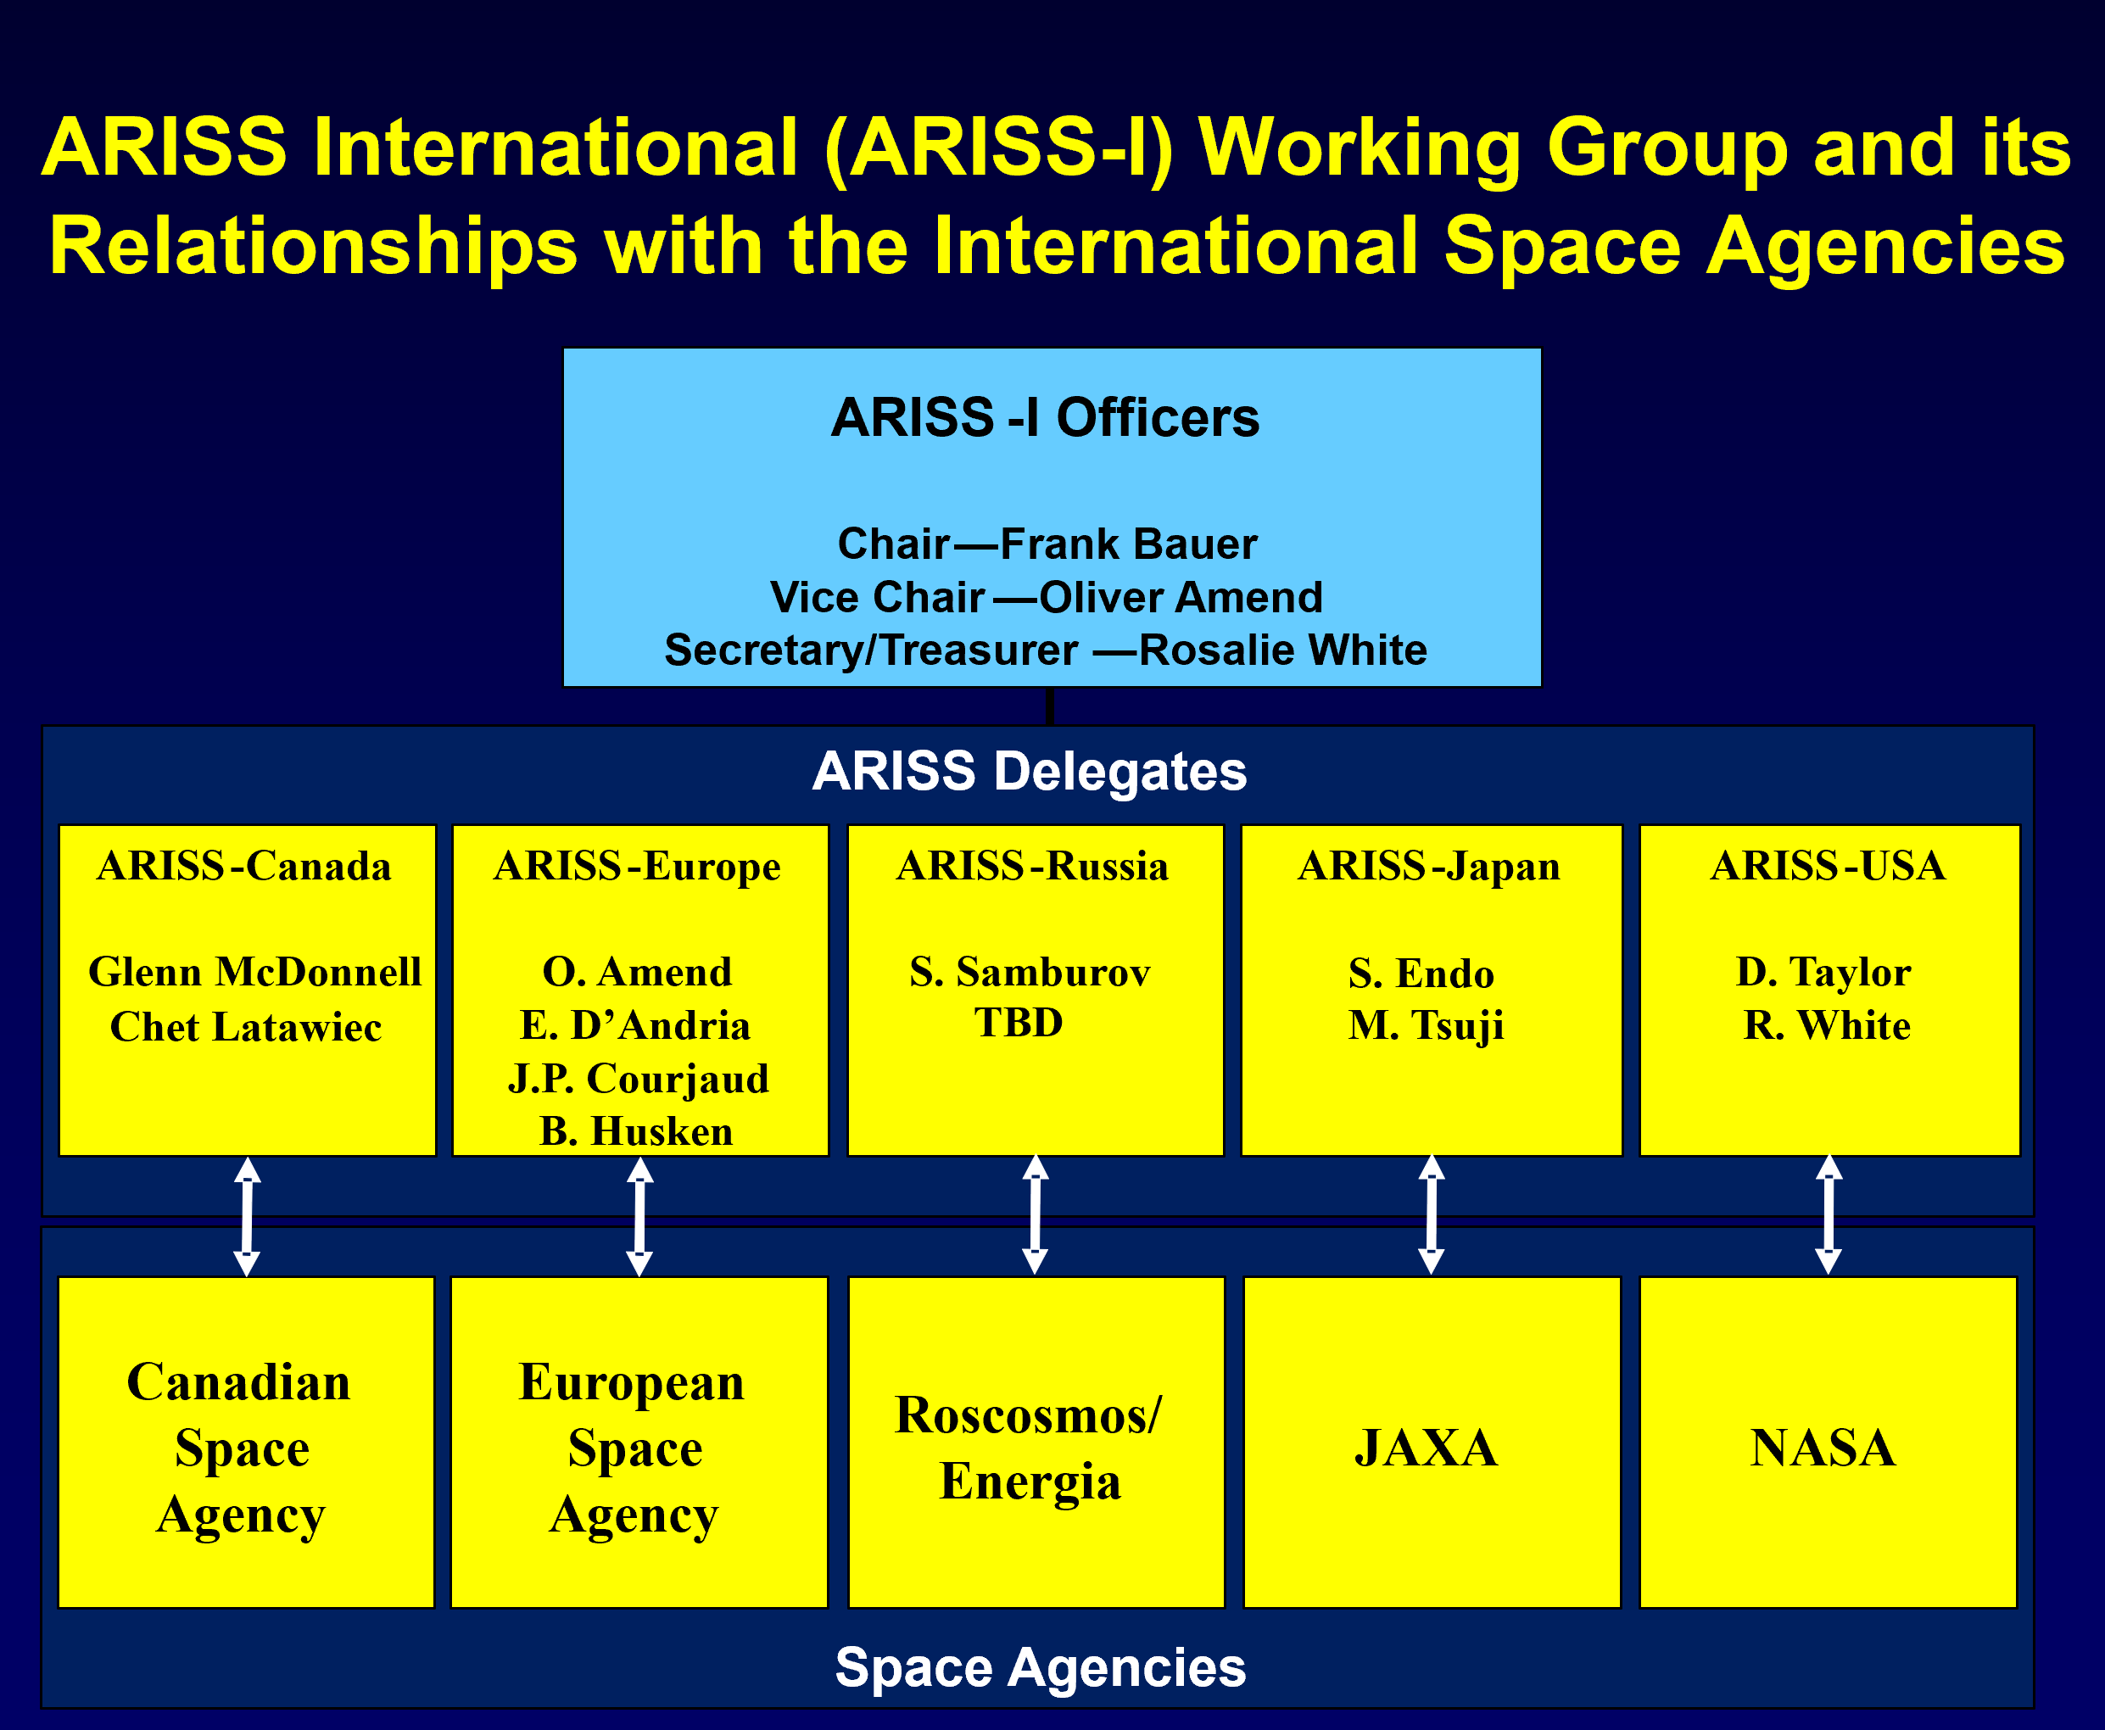
AREx Team and
Systems Integration Approach
AMSAT/Project OSCAR pioneered DIY satellites starting with OSCAR-1 launch in 1961; to date over 100 OSCAR satellites launched in LEO, GEO, and HEO; 50+ years of multi-lateral satellite developments by world-wide network of volunteers; Surrey Satellite (SSTL) derived from AMSAT initiatives; AMSAT member co-inventor of CubeSat; ARISS pioneered ISS satellite deployments via SuitSat-1
For AREx, combined ARISS AMSAT/ARISS international working group
Emulates ARISS-International and encompasses ARISS, AMSAT-NA (US, Canada, S. America), AMSAT-UK, AMSAT-DL (Germany) and JAMSAT (Japan)
Single amateur radio focal point to NASA and Gateway space agencies—education, operations, systems development & integration and technical
International working group will be aligned to Gateway Space Agency participation
No proprietary data downlinks (ITU/FCC law for amateur radio)
Data sharing through open Repo
Hardware development plan: Leverage existing systems and capabilities developed for ARISS and AMSAT (ARISSsat, HamTV, GOLF CubeSat, CubeQuest Challenge) to minimize risk and schedule
Funding through in-kind volunteer labor and donations/grants (standard AMSAT/ARISS model)

Slide 13
AREx payload Concept
AREx Mark 1 System: Minimally Capable Educational Outreach System; Flown Soonest
  Externally mounted “satellite” payload with fixed antennas & cameras attached; optional deployable boom for greater visibility
  Develop 2-3 spacecraft copies that will be externally attached to each Logistics Module flown to support lunar human spaceflight missions
  Simple ground station using COTS components and AREx embedded soft/firmware & data interfaces
  Gateway operations timeframe: Soonest on Gateway Phase 1; target delivery: early 2024
AREX Mark 2 System: Foundational Educational outreach system
  Fully capable system, internally mounted on Gateway employing RF feedthroughs to Earth-pointed 0.6 m dish or flat plate antenna
  Simple ground station using COTS components and AREx embedded soft/firmware & data interfaces
  Gateway operations timeframe: starting around 2026-2027

Slide 14
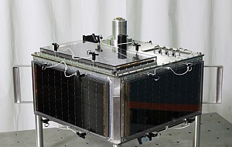
AREx Mark 1
System Overview
ARISSat spaceframe, human spaceflight certified; 3 units available
Commandable antenna/camera array “communications/video hat” (CV Hat) eliminates pointing system
Option: CV Hat on deployable boom; based on Earth visibility constraints
Enhanced Software Defined Radio employing DVB-S2X technology for simple ground station transmit/receive & weak signal capture
Experiment interface for STEAM student investigations
Leverage systems and interfaces developed through ARIISSat along with pioneering DVB-S2 capability employed on ARISS HamTV
Supports voice, lunar/Earth pictures, Television (low bandwidth), experiment data, Twitter-like messages, telerobot commanding between schools
ARISSat
With
CV Hat
on top
AREx Mark 1
CV Hat
Deployable
Boom
AREx Mark 1 Option

Slide 15
AREx Mark 1 System
Payload Characteristics
Operational Volume: 61 x 61 x 30 cm
On-orbit Mass: 35 kg
Power: 250 W; tolerate planned shutdowns or outages
External Data/command: Not needed
External Video/imagery: Not needed
External Computing resources: Not needed
Other Requirements: Not needed
Mechanical interface: SORI or hard mounted
Hazards to mitigate: Non-ionizing radiation, deployable boom (if option exercised)
Major challenge: Thermal
ARISSat
With
CV Hat
on top
AREx Mark 1
CV Hat
Deployable
Boom
AREx Mark 1 Option

Slide 16
AREx Mark 1 System
Radio Capabilities
ARISSat
With
CV Hat
on top
Normal Ops Downlink: X-band 10.45-10.5 GHz
Contingency Ops Up/Downlink: 70 cm band 435-438 MHz
Normal Ops Uplink: C-Band 5.65-5.67 GHz
Normal Ops Modulation: DVB-S2X (supports Voice, Data, SSTV—Pictures, Video)
Contingency Ops Modulation: Various weak signal communications modes (e.g. JT65, FT8, Olivia MFSK-16, BPSK-31)
AREx Experiment/engagement interface—four ports (e.g. MarconISSta, video feeds, student experiments)
Can support radio/technology tech demos and science investigations, similar to AO-40 GPS technology experiment or ISS MarconISSta experiment investigation
AREx Mark 1
CV Hat
Deployable
Boom
AREx Mark 1 Option

Slide 17
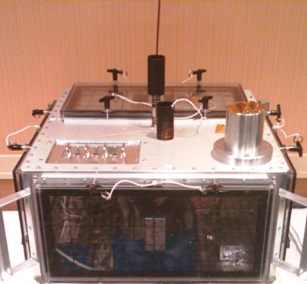
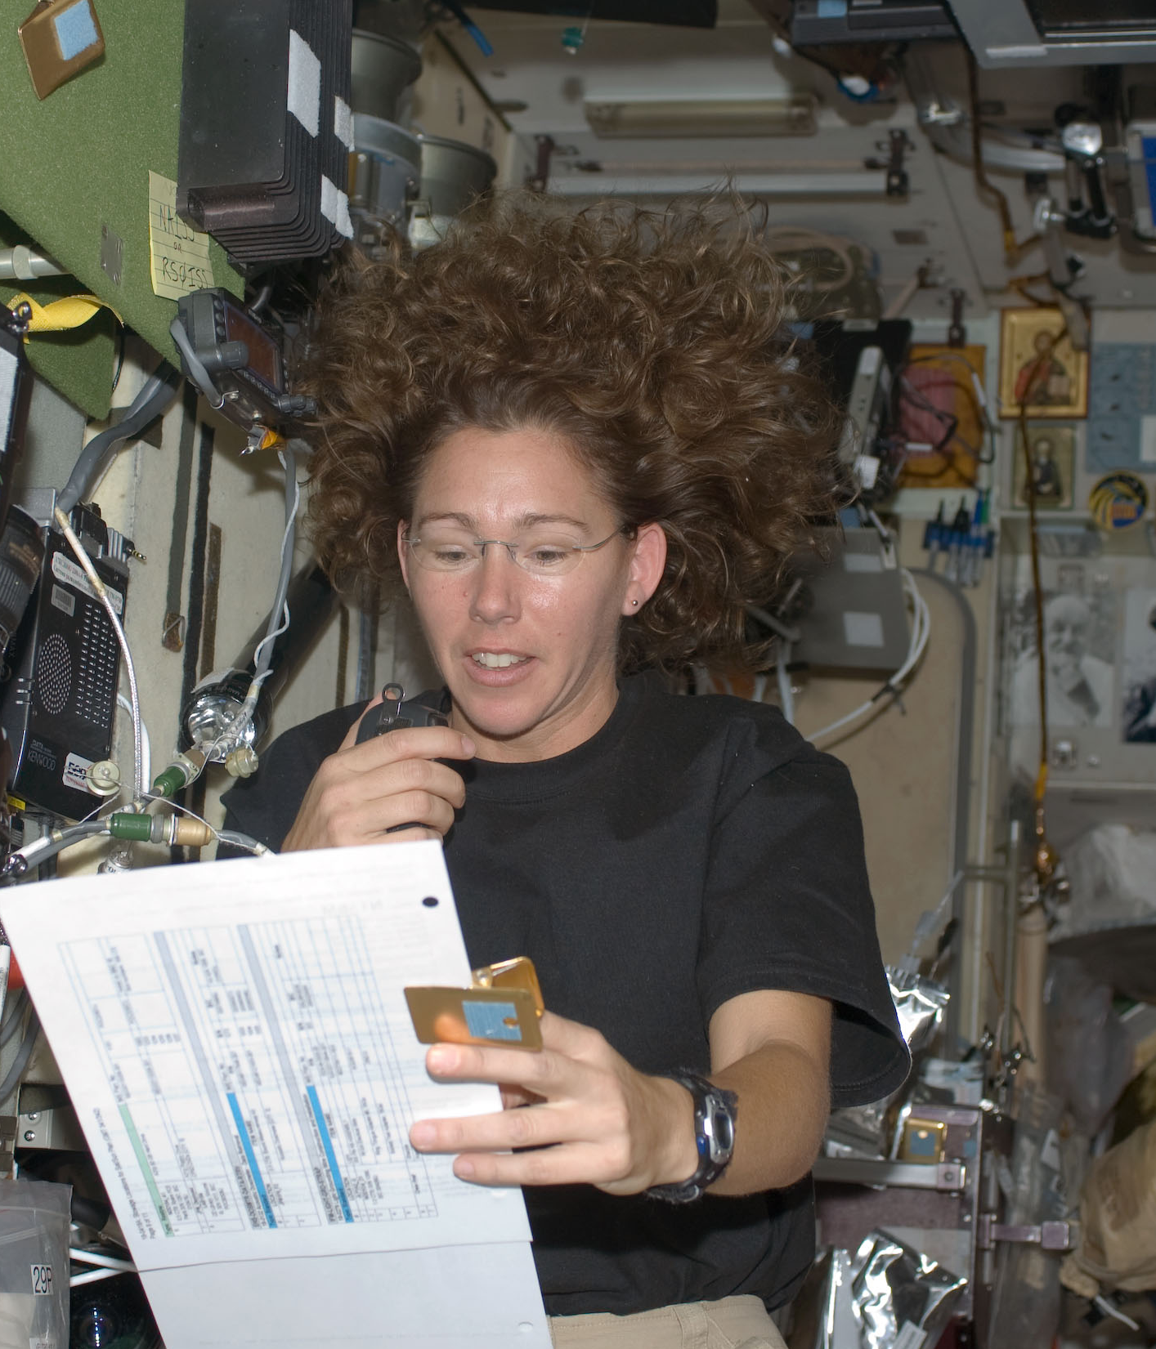
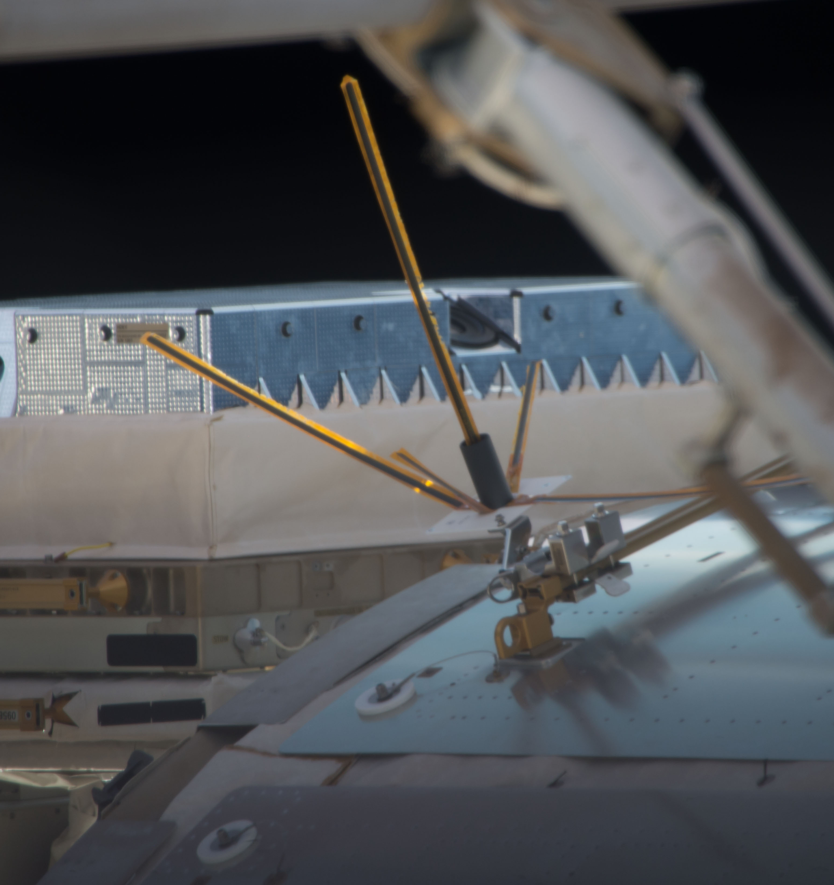
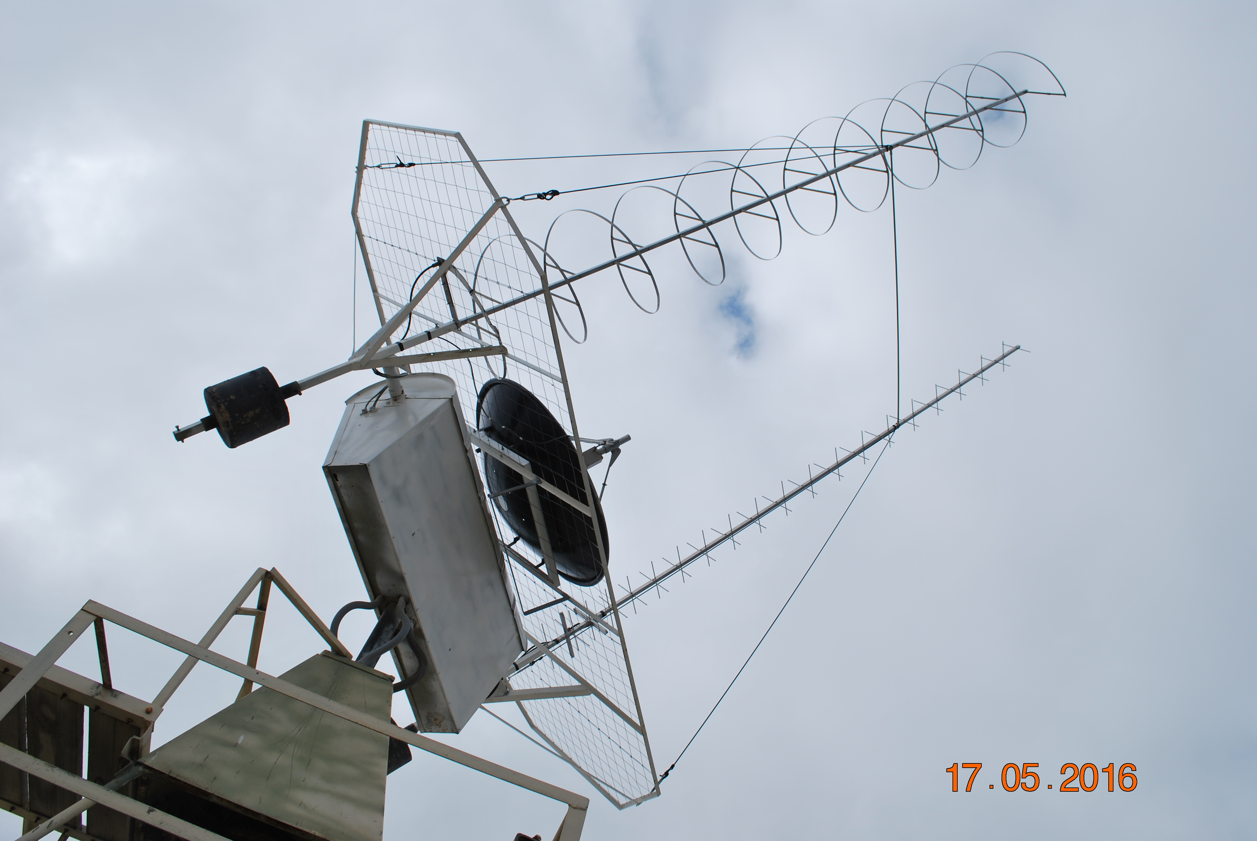
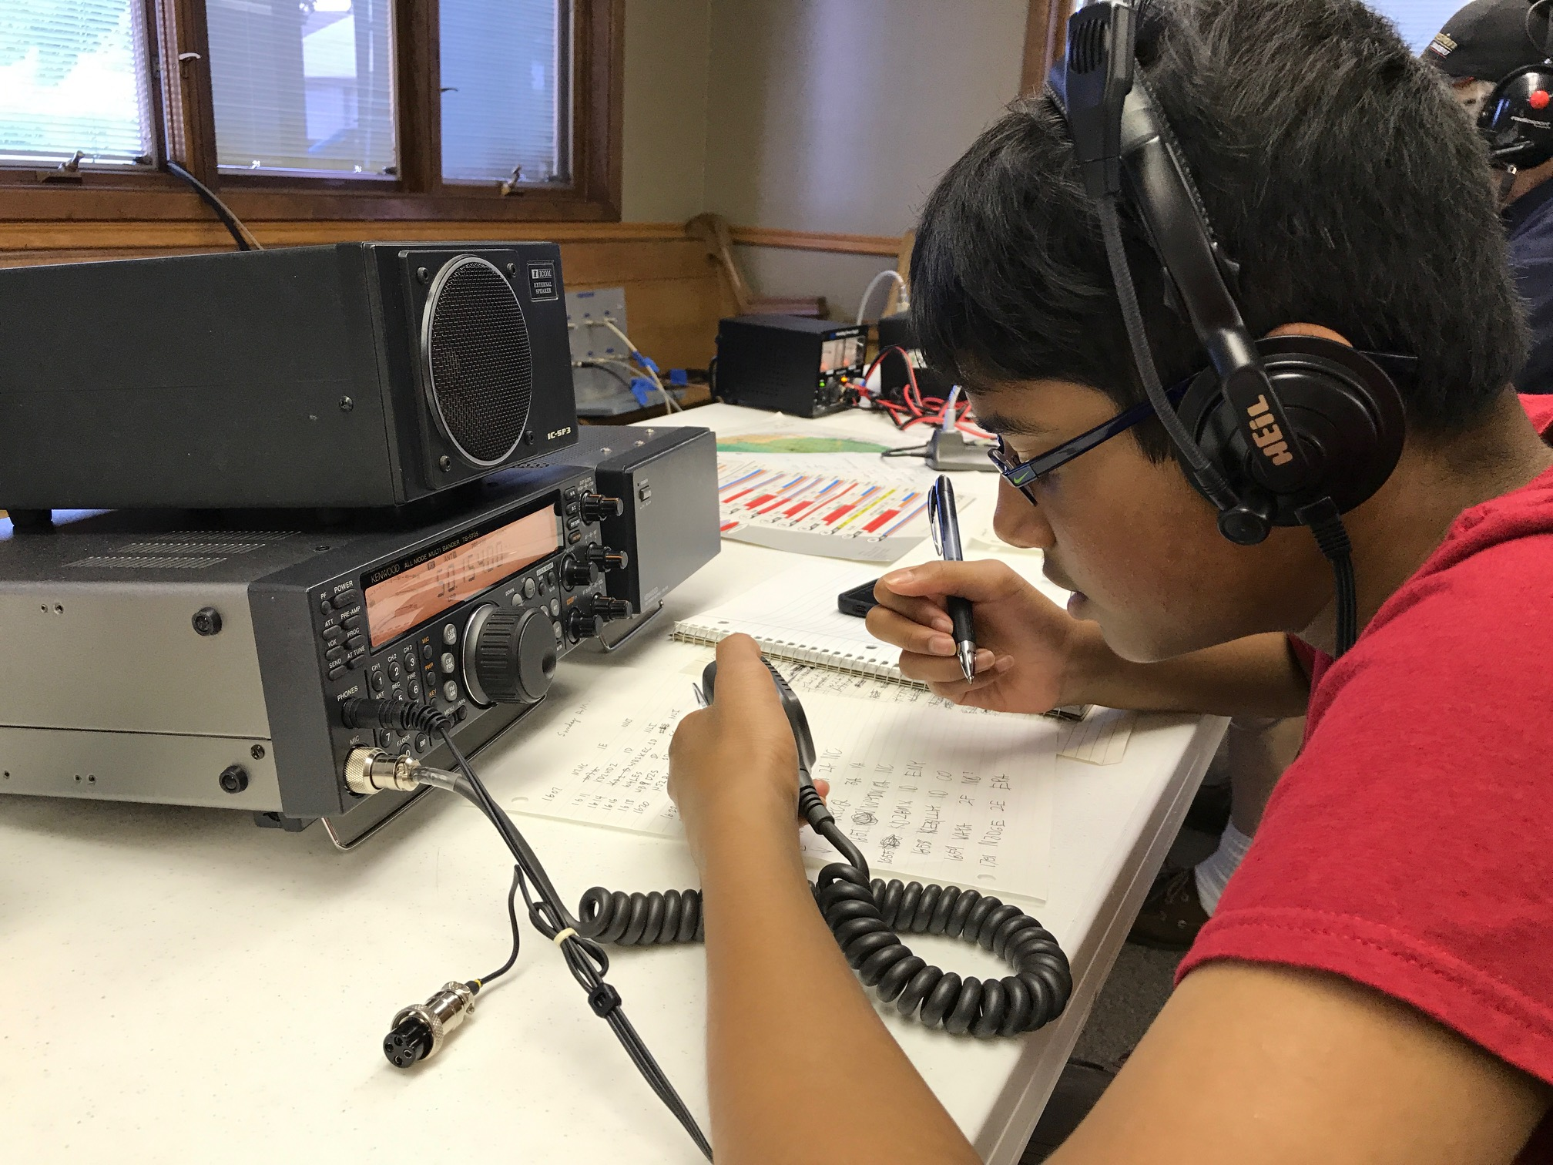
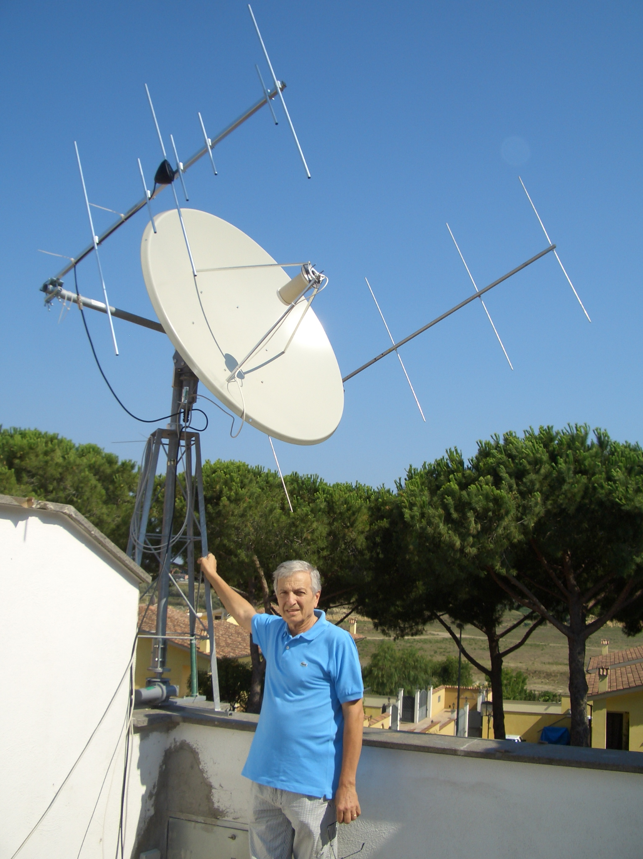
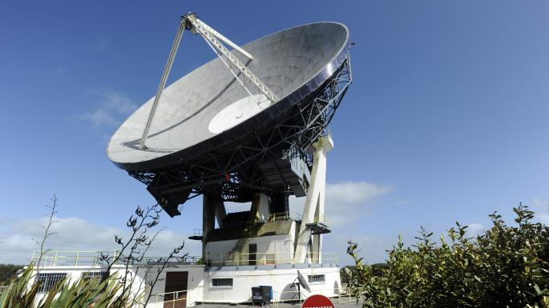
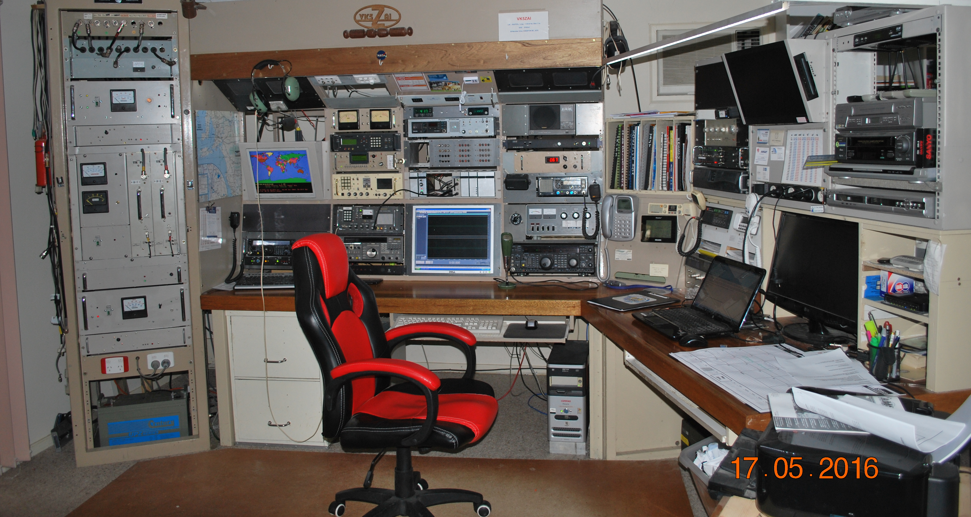
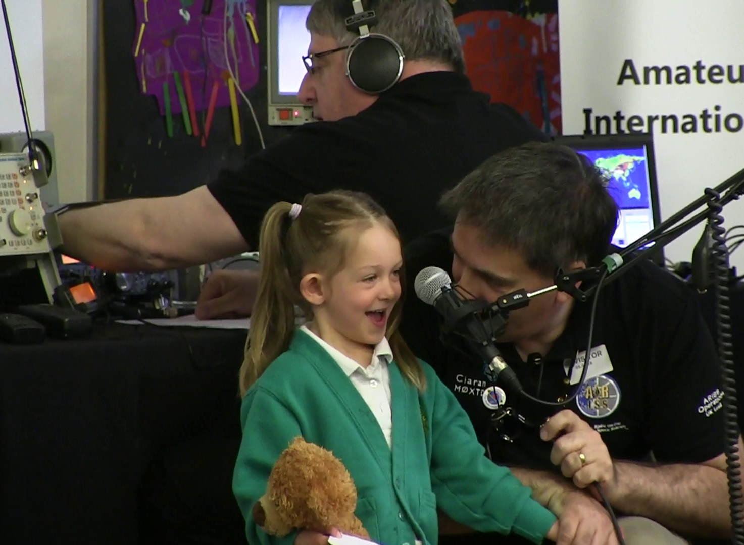
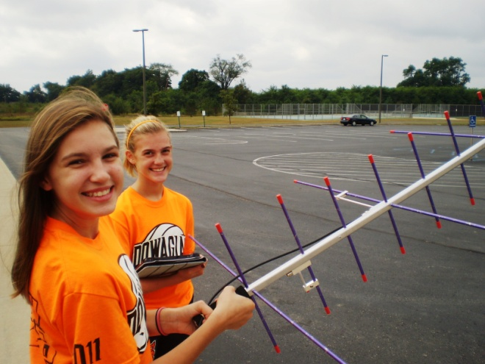
AREx Operational Segments
Space Segment
Crew Tended|Autonomous
User Segment
Educational Outreach|Amateur Ops|Experimental Scientific
Operations Control Segment
Nominal|Contingency Ops

Slide 18
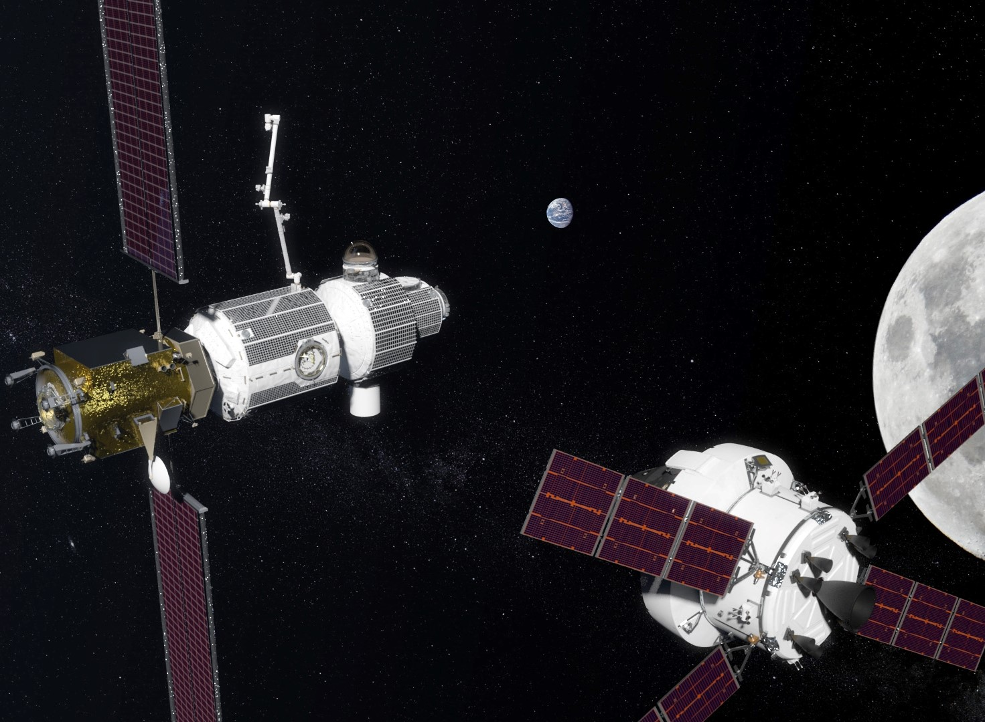
AREx Operational Scenarios
70 cm Band (435-438 MHz) AREx contingency ops
X-Band (10.45-10.5 GHz)
C-Band (5650-5670 MHz)
X-Band (10.45-10.5 GHz)
Operation Plan:
Nominal: X-band TX Prime; 70 cm Rx only
Contingency: 70 cm TX Prime; X-band TX off
C-Band (5650-5670 MHz)
AREx Gnd Stations
- Cmd
TLM
Contingency
Users
- Schools & General Public (RX only)
- Amateur Radio Operators (RX & TX)
- Experimental/Scientific (RX & TX if licensed)
Bochum, GAVRT, & Goonhilly
Telebridge Network
BATC Server RX Distribution

Slide 19
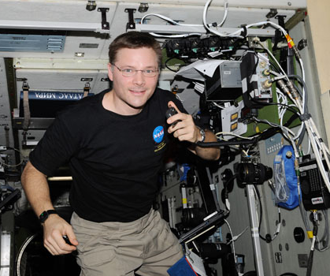
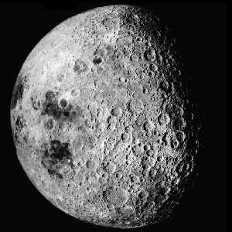

Gateway
Proposed On-Orbit operations concept
Crew Engagement
1-2 months/year
School Contacts (Audio only & w/video downlink)
SSTV (Picture up/downlink)
Experiment setup & (optional) ops
Random Voice Contacts
Robotic Engagement
24/7/365
Ham Video downlinks (Earth, Moon, AREx student experiments) Earth/moon phases, Earth weather
APRS: Telerobotic command, twitter-like msgs
Voice Repeater
SSTV Pictures & Educational Puzzles
Experiment & Ham Station Telemetry
Weak signal challenges

Slide 20
Gateway Education
Far Side of the Moon
Students could use code and program a camera on Gateway to take pictures of the moon, the Earth or other parts of the universe
Our Earth
With the visual footprint being so large, students could view pictures or video from Gateway and learn to identify parts of the Earth, learning about the culture, people and landforms.
Can turn the camera to also look into deep space

Slide 21
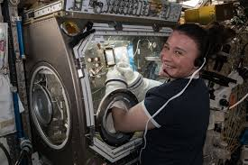

Gateway Education
EchoLink & Other Capabilities
Radios can be expensive, but phone apps are cheap!
Students could communicate with each other using an EchoLink node installed on Gateway
Ham radio voice repeater also available for student to student chats
Morse Code and other codes can be used by students and astronauts
Science Experiments
Students and astronauts conduct parallel experiments
Results shared via radio or recorded to share later

Slide 22
Additional Operations information to NASA
Pointing information:
  Antenna prefers clear field of view to Earth 24/7/365
  Antenna array to be mounted in Sun-Earth plane for maximum visibility
  Predictable blockages are OK
Operational timing:
  Prefer to fly soonest to engage students and general public in early exploration
  PPE (and HALO) great opportunity but with few SORI interfaces
  Logistics module looks most promising from availability and field of view to Earth; interesting opportunity is to continue student exploration operations after undock; how long operational after undock?
Internal/External:
  Prefer internal for radio system and external for antenna but can support all external as baselined
  ARISSat spaceframe and antenna/camera platform can be separated via coax; radio can be installed in module with antenna on exterior if RF feedthrough exists
Ops duration: Years—can build multiple Mark 1 copies and install permanent Mark 2 system when appropriate
Disposal plan: If on Logistics module, dispose (and operate for a time) in/on module

Slide 23

AREx Gateway Mark 1 Development Schedule
Jan 2020
Feb 2020
Mar 2020
Apr 2020
May 2020
Jun 2020
July 2020
Aug 2020
Sep 2020
Oct 2020
Nov 2020
Dec 2020
Preliminary Design Development
MCR
SRR
Prelim Design
Review
Jan 2021
Feb 2021
Mar 2021
Apr 2021
May 2021
Jun 2021
July 2021
Aug 2021
Sep 2021
Oct 2021
Nov 2021
Dec 2021
Design Maturation to
Final (Critical) Design
HW Fabrication
Phase 0/1
Safety Review
Final (Critical) Design Review
Phase 2
Safety Review

Slide 24
AREx Gateway Mark 1 Development Schedule
Jan 2022
Feb 2022
Mar 2022
Apr 2022
May 2022
Jun 2022
July 2022
Aug 2022
Sep 2022
Oct 2022
Nov 2022
Dec 2022
Hardware Fabrication
Environmental, EMI/EMC, Power Quality Testing
Jan 2023
Feb 2023
Mar 2023
Apr 2023
May 2023
Jun 2023
July 2023
Aug 2023
Sep 2023
Oct 2023
Nov 2023
Dec 2023
Test Report Delivery
Safety & Engineering Verifications
Phase 3
Safety Review
Flight Model 1
HW Delivery
To JSC

Slide 25
AREx Payload Systems
Agenda
Systems overview—Frank
Link Budget, Orbit/Attitude/Signal Availability—Chris, Achim, Ken E.
Mechanical—Tom S, Chris
Electrical (Power, SDR/RF systems, TTNC, Software,
Antenna system)—Lou, Michelle, Chris, Doug
Thermal—Tom S.
Ground station--Michelle

Slide 26
Sun Vector
Habitation and Logistics Outpost (HALO)
Logistics Module
Lunar Lander Concept
Power and Propulsion Element (PPE)

Slide 27
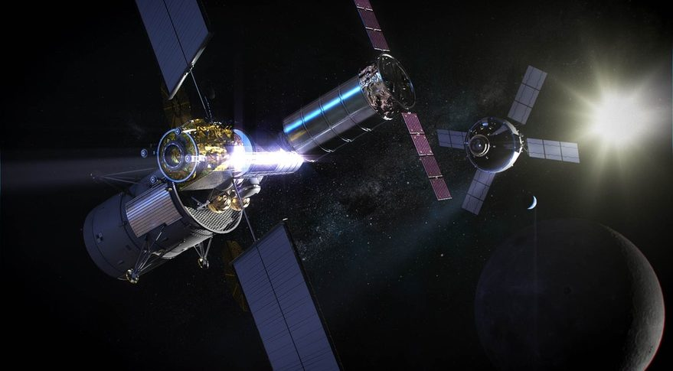
Orion
Crew Vehicle
Power and Propulsion Element (PPE)
Lunar Lander Concept
Habitation and Logistics Outpost (HALO)
Logistics Module

Slide 28
reference orbit + attitude
orbit simulated with GMAT R2018a
trajectory data taken from publicly available JPL SPICE kernel
hypothesis: station attitude is sun-pointing
define azimuth axis pointing north and 0 deg elevation parallel to the plane of the lunar orbit

Slide 29
preliminary results
azimuth varies over one lunar orbit by 360 degrees (as expected)
elevation varies between +14.4 deg and -5.1 deg above and below the lunar orbit plane
gateway to earth center range varies between 360425 km and 426600 km (superimposed effect of lunar orbit and NRHO)

Slide 30

working hypothesis: antenna on gateway
use ‘antenna on stick’ to get clear of gateway structure wrt. antenna beam (single deployment event)
use 8 semi-directional antennas with -3 dB beamwidth of 50 deg in azimuth and 25 deg in elevation so resulting pattern is toroidal and in-plane wrt. lunar orbit around earth
switch between antennas twice every week (29 days for 360 deg) to account for change of azimuth, maybe automatically (diversity receiver)
estimate antenna gain: $G_{d}=\left(\frac{31000}{50∗25}\right)=24.8=13.9 dBi$
(independent of frequency)

Slide 31
further assumptions (to be checked by Michelle T.)
on gateway: 10/50/100 Watt RF power
various types of modulation and datarates:
emergency data (FT8)
analogue voice (SSB: 2.5 kHz BW)
digital data (DVB-S2/X, GSE)
assume X-band downlink
(10.5 GHz, Tsys=150K, 1m parabolic antenna with G=38.6 dBi)
emergency comms: assume UHF downlink
(435 MHz, Tsys=300K, 0 dBi omnidirectional antenna gain)

Slide 32
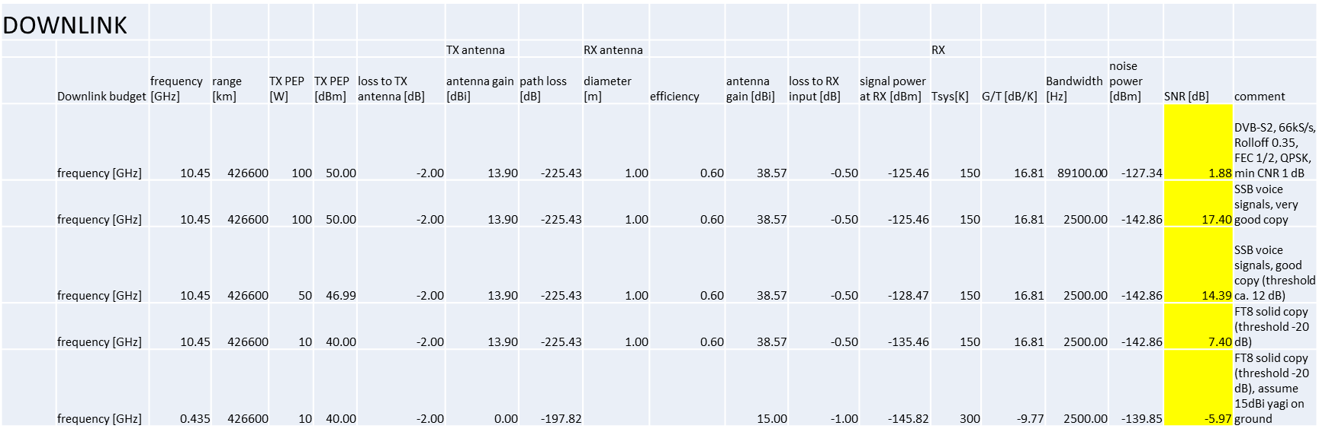
preliminary link budget analysis
(Updated Chart)

Slide 33
conclusion (prelim.)
video: DVB-S2 (just) possible with 100 W RF power: low symbol rate (66 kS/s) and high FEC (1/2) with 1.0 m antenna on ground, DVS-S2X with better performing VL SNR MODCODs increase margin by a few dB
voice: SSB very good copy with 100 W, good with 50 W
low data rate formats: FT8 solid copy with 10 W
emergency comms: FT8 on s/c omni and 10 W results in good copy on ground (provided some directional antenna gain at ground station)

Slide 34
AREx Payload Systems
Agenda
Systems overview—Frank
Link Budget, Orbit/Attitude/Signal Availability—Chris, Achim, Ken E.
Mechanical—Tom S, Chris
Electrical (Power, SDR/RF systems, TTNC, Software,
Antenna system)—Lou, Michelle, Chris, Doug
Thermal—Tom S.
Ground station--Michelle

Slide 35
AREx Payload Systems
Agenda
Systems overview—Frank
Link Budget, Orbit/Attitude/Signal Availability—Chris, Achim, Ken E.
Mechanical—Tom S, Chris
Electrical (Power, SDR/RF systems, TTNC, Software,Antenna system)—Lou, Michelle, Chris, Doug
Thermal—Tom S.
Ground station--Michelle

Slide 36
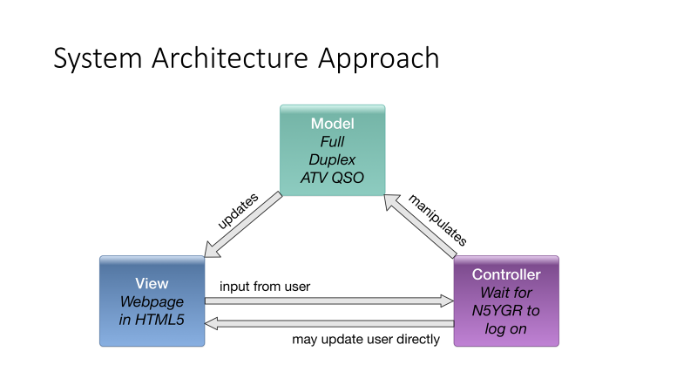

Slide 37
AREx System Architecture Update 25 June 2020
Four Boards, Four Hardware States, Fault Tolerant
Digital Multiplexing Transceiver – regenerative system
Switches over to Analog Transponder in case of Digital Board Failure
10 GHz Downlink is DVB-S2/X and GSE
5 GHz Uplink Native Digital Mode is 4-ary MSK (any mode possible)
Accessibility by Design
20200617-AREx-System-Architecture distributed 17 June 2020

Slide 38
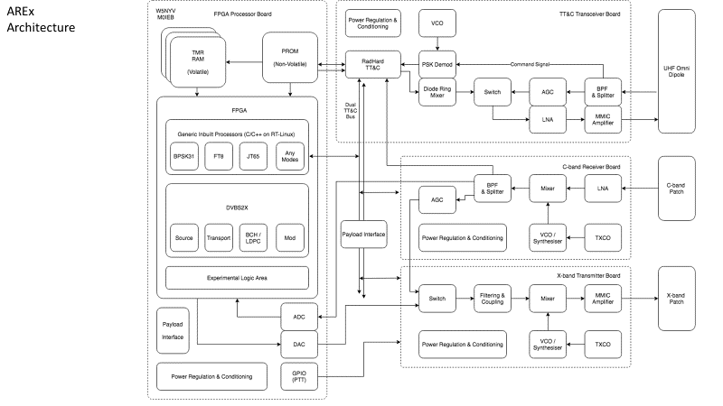

Slide 39
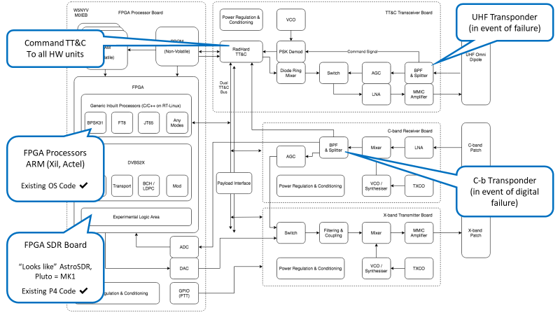

Slide 40
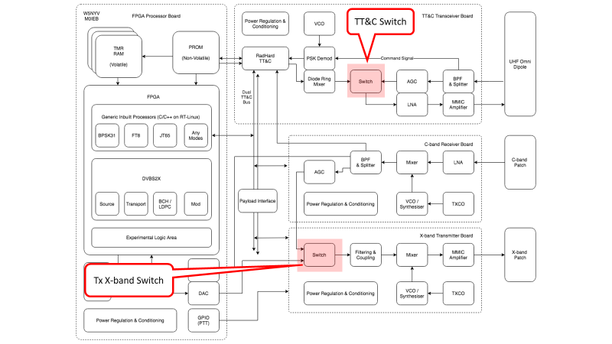

Slide 41
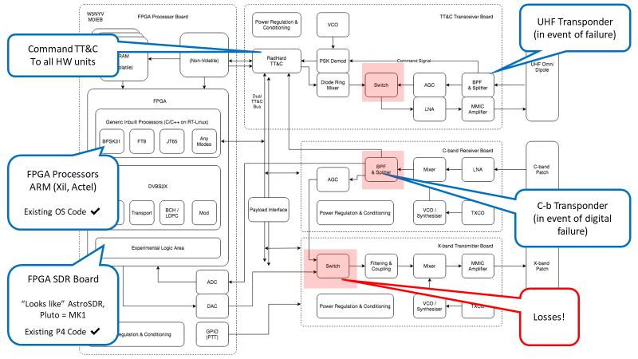

Slide 42
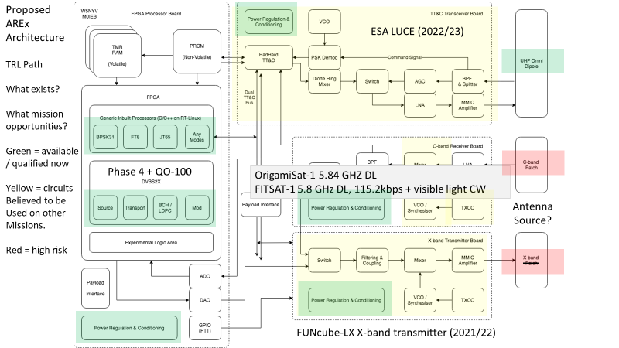

Slide 43
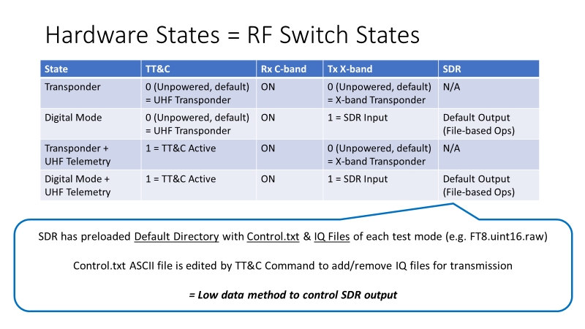

Slide 44
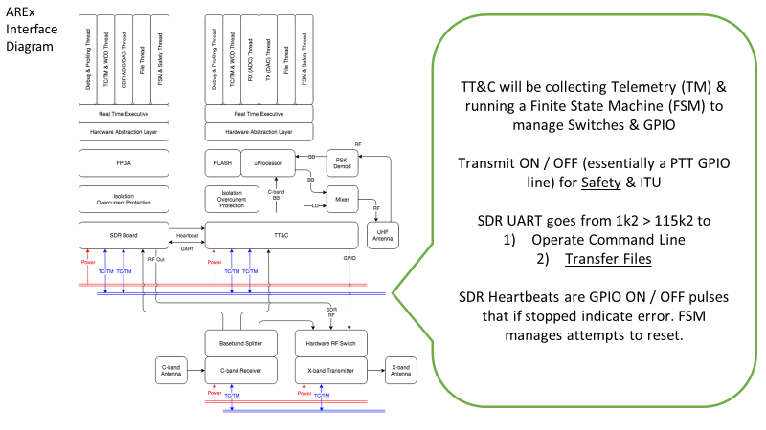

Slide 45
TT&C System
Modeled after an ‘Intelligent’ Router
Sample, receive, decode, route incoming packets / frames to all systems (& the reverse too)
Collect telemetry to make local Safety Decisions with Updatable Defaults
E.g. HPA is too hot, or timer default values need updating to new values

Slide 46
TT&C Bus
TT&C Bus needs to be Multi-Master , Hot Swappable & Low Power
Multi-master means TT&C can control / drive switches & payload state
Hot Swappable means systems can be plugged / powered in or out (in testing, through failure, etc)
AND SDR FPGA can do the exactly same
= Fast & Flexible Design
Interface should be reusable where possible (mech, elec, software)

Slide 47
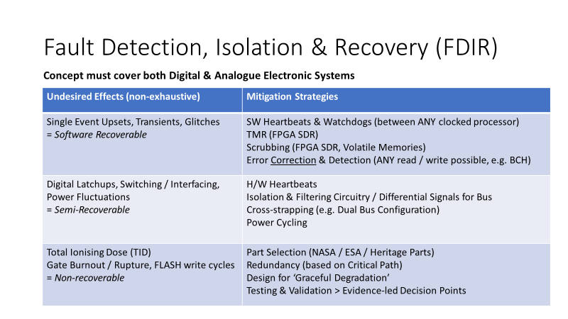

Slide 48
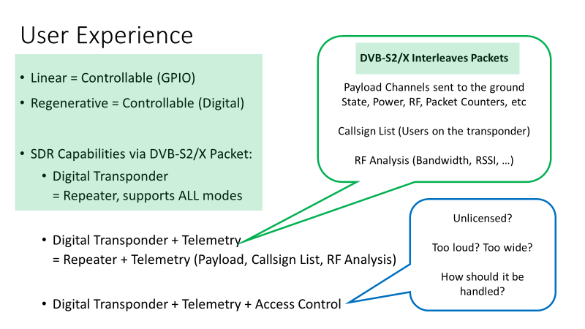

Slide 49
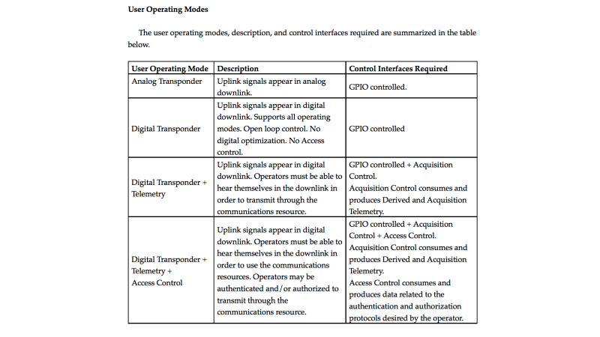

Slide 50
Controllers
Default SDR transmission with a configuration file
Adaptive Coding and Modulation with Finite State Machine
Failure Mitigation with Finite State Machine
Acquisition Control with Finite State Machine
Access Control with Finite State Machine
Hardware State with Finite State Machine

Slide 51
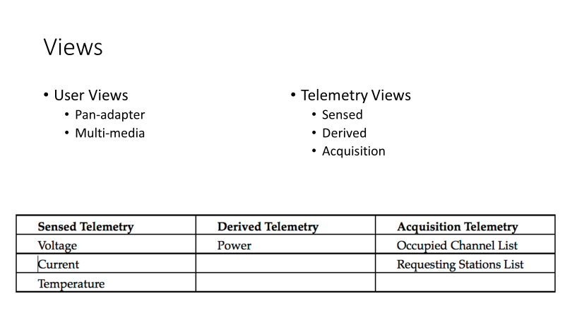

Slide 52
Camera Options
SDR FPGA has Payload Interface
Tightly Coupled, can only operate when SDR FPGA is in operation
Power Modes also coupled
Likely to be fast
SDR FPGA Testing coupled with Camera
Camera has own TT&C Bus Interface
Decoupled, but needs additional interface & processing circuit
Flexible to power / mode requirements
Likely to be slower
Camera needs independent testing

Slide 53
AREx Telemetry Software
Ideas and Concepts
The software should look and feel "cool" to a fifth grader, while still being useful to experienced telemetry users.
The software should be visually oriented including photos of the object and its telemetry where possible but also use straight listings of values where appropriate for more experienced users. We need a 3D digital model of Lunar Gateway once it is available. NASA hasn’t published a 3D model (yet) unlike other spacecraft/probes (https://nasa3d.arc.nasa.gov/models)
Targeting Windows and Linux using the same source code.
Probably C programming language (probably with Qt widgets) – TBD
Open Source (GPL, probably GPL 2 maybe 3, TBD)
Github or Gitlab (TBD) public repository for source code (and bug tracking?)
Telemetry received by the ground stations will be sent in real time to a central repository and consolidated onto a real time webpage showing the decoded telemetry values (similar to webpages for ARISSatTLM and FoxTelem)
Ground station statistics and leaderboard published on the web to encourage competition and recognize ground station participation
Leverage existing AMSAT telemetry software and infrastructure if/when possible. Don’t reinvent the wheel and avoid Brooks’s “second system” effects.

Slide 54
AREx Telemetry Software
TO DO
Downlink telemetry format (what bytes are going to be sent in what order) has not been determined yet
Downlink telemetry values (what do those bytes *mean*) needs to be determined (voltage? of what? temperature? of what?)
Telemetry conversion equations (that is, the value "42" in the telemetry "means" 5.0 volts) need to be determined
Needs a "cool" catchy name for the telemetry software, tentatively the telemetry software will be called "ARExTLM"
Needs a "really cool" if unofficial project code name (perhaps "Golden Earring" because of their lyrics “My beacon's been moved under moon and sky" but the band or NASA might object, so maybe something else… :-)
HELP WANTED – contact Douglas dquagliana@gmail.com

Slide 55
AREx Payload Systems
Agenda
Systems overview—Frank
Link Budget, Orbit/Attitude/Signal Availability—Chris, Achim, Ken E.
Mechanical—Tom S, Chris
Electrical (Power, SDR/RF systems, TTNC, Software,Antenna system)—Lou, Michelle, Chris, Doug
Thermal—Tom S.
Ground station--Michelle

Slide 56
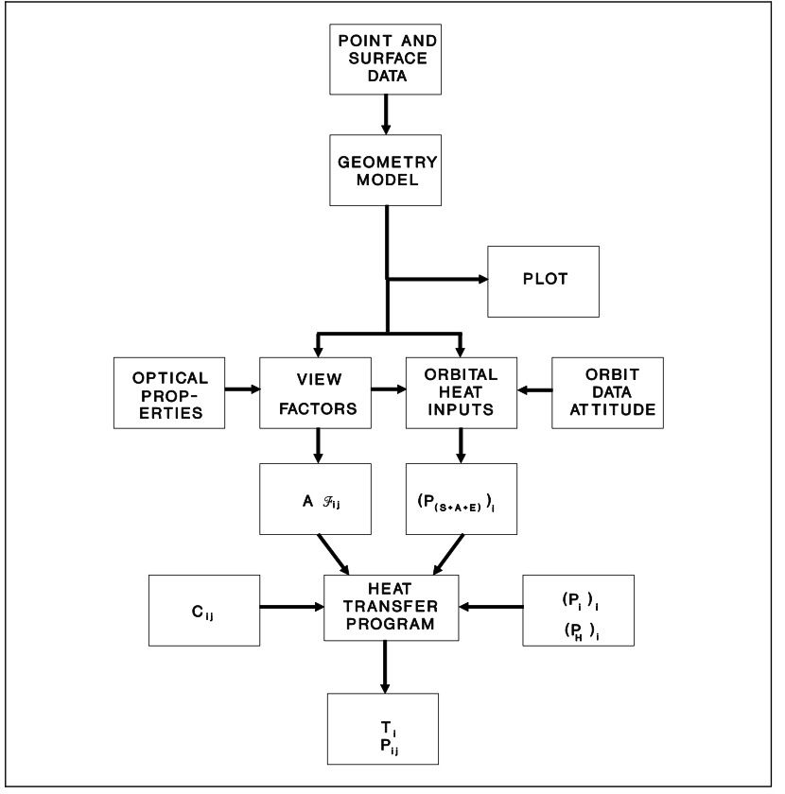
NASA Design Guidelines GD-AP-2302

Slide 57
Requirements
Internal/External Heat source identification
    Heat Flux profile from orbit
        Solar radiation, albedo
    Dissipated Heat from Radio, instruments, power supplies, batteries
Geometry
      Mechanical Design
Operating Ranges for Components

Slide 58
Initial Phases
Settle on a simulator
    open source or not(?)
  Import sample CAD drawing to a mesh description
  Assume fixed 300W power source
  Simple model of ambient temperature (+- 250 C)
  Initial evaluation of heating/cooling needs

Slide 59
Results
Initial estimate of temperature swings
Possible Hot Spot determination
Heating and Cooling requirements
Ability to iterate analysis as design proceeds

Slide 60
AREx Payload Systems
Agenda
Systems overview—Frank
Link Budget, Orbit/Attitude/Signal Availability—Chris, Achim, Ken E.
Mechanical—Tom S, Chris
Electrical (Power, SDR/RF systems, TTNC, Software,Antenna system)—Lou, Michelle, Chris, Doug
Thermal—Tom S.
Ground station--Michelle

Slide 61
Requirements
Jin Kang
Chris Bridges

Slide 62
Level 1 (Top Level) Requirements
[MIS-1] The AREx Payload shall support a comprehensive educational engagement program on Gateway that will inspire, engage and educate youth and communities in Science Technology Engineering, Arts and Mathematics (STEAM)
[MIS-2] The AREx Payload shall support contingency communication
[MIS-3] The AREx Payload shall support autonomous, commandable (spacecraft-like) operations and occasional interactive operations with an on-board crew
[MIS-4] Development of the AREx payload (flight) system and ground system shall be at no cost to the space agencies. (request will be made for Gateway integration and payload launch)
[MIS-5] Shall include multiple operation modes in order to support different modes of operation.
[MIS-6] The AREx payload shall establish reliable communications with Earth ground communications no less than 100 hours per month
[MIS-7] The AREx Mark 1 payload shall be installed on an outside segment of the lunar Gateway

Slide 63
Level 2 (Systems) Requirements
[SYS-1] The AREx Mark 1 payload shall include interfaces to support up to 4 student experiments [MIS-1]
[SYS-8] AREx shall provide camera feed from multiple cameras [MIS-1]
[SYS-2] Shall have contingency communication system that is independent of the primary communication system [MIS-2]
[SYS-3] Shall be able to establish communication through contingency comm system under unpredicted Gateway attitudes [MIS-2]
[SYS-4] The AREx payload shall support minimum of one contingency mode using an independent frequency set [MIS-2]
[SYS-5] The nominal operations modes shall include minimum of three nominal operations modes, including
  Educational Outreach and Public Engagement
  Amateur Radio Operations
  Experimental Scientific Mode [MIS-5]

Slide 64
Level 3 (Subsystem) requirements
AREx Payload Enclosure
Except for the antenna/camera “Hat,” all AREx systems shall be enclosed in an ARISSat spaceframe or equivalent [SYS-7]
The AREX Mark 1 system, shall support communications from lunar orbit on Gateway to ground stations on Earth without the use of a pointing system [SYS-2,3,6]
The payload shall be configured to interface with the Gateway Small ORU Robotics Interface (SORI) mechanically and for power and Gateway data [SYS-7]
Mass of AREx shall not exceed TBD kg [SYS-9]
Voluem of AREx shall not exceed X x Y x Z cm [SYS-9]
Video Communications “Hat”
The Mark 1 payload shall include a Communications/Video “Hat,” or “CV Hat” with multiple cameras and antennas included [SYS-8]
CV Hat shall be able to provide photo documentation of the Earth and the Moon [SYS-8]

Slide 65
Level 3 (Subsystem) requirements
(Continued)
Power
The AREx payload power consumption shall not exceed 300 W [SYS-9]
Communications
The AREx system shall support primary downlinks on the amateur X-band (10.4 GHz) [SYS-2,3,4,6]
At a minimum, the AREx primary uplink shall reside on the amateur C-band (5.7 GHz) [SYS-2,3,4,6]
Contingency communications (up and downlink) shall reside in the amateur UHF band (435-438 MHz) [SYS-2,3,4,6]
Nominal operations shall use the DVB-S2 modulation [SYS-5]
Nominal Up and downlink communications shall be conducted via voice, data, video and SSTV (low and high resolution pictures) [SYS-2,3,4,6]
System Architecture
It shall define a model and control system that prioritizes reliable amateur communications.
It shall define a control system that detects and adapts to digital subsystem failures.
It shall define views that are open, accessible, and documented.

Slide 66
Level 3 (Subsystem) requirements
(Continued)
Ground System
Ground system design shall include reasonable accessibility accommodations for disability [SYS-1]
The ground station user interface shall include features that maximize user friendliness [SYS-1]
The ground Station user interface shall be based in HTML5 to leverage known good UI libraries and incorporate best practices

Slide 67
Concept of Operations (Conops)
Ciaran Morgan

Slide 68
Concept behind ConOps
Tried to develop a Concept of Operations for the Lunar Gateway that drew upon the experience of ARISS from the last 20 years
Interactive and inspiring with the Crew Members
Usable with or without the Crew Members present
Ability to engage with the widest possible audience
Flexible to change given new opportunities/missions

Slide 69
Gateway
Proposed On-Orbit operations concept
Crew Engagement
1-2 months/year
School Contacts (Audio only & w/video downlink)
SSTV (Picture up/downlink)
Experiment setup & (optional) ops
Random Voice Contacts
Robotic Engagement
24/7/365
Ham Video downlinks (Earth, Moon, AREx student experiments) Earth/moon phases, Earth weather
APRS: Telerobotic command, twitter-like msgs
Voice Repeater
SSTV Pictures & Educational Puzzles
Experiment & Ham Station Telemetry
Weak signal challenges

Slide 70
Proposed modes for ConOps
Amateur Mode
Educational Outreach Mode
Experimental/Scientific Mode

Slide 71
ConOps : Amateur Radio Mode
Mode expected to be operational when other modes not selected.
  Development and use of the Amateur Radio equipment in various modes such as voice and video transponder modes.
  Continuation of ISS “Random” contacts by crew from Lunar Orbit.
  Expected to be controlled/managed in an autonomous manner from Earth, including when the Gateway is crewed.

Slide 72
ConOps : Educational Outreach Mode
Mode expected to be operational in both crewed and uncrewed scenarios
Crewed
  Live, two way, communication exchanges, similar to existing ARISS Contacts between schools and crew members on the Gateway.
  Controlled/managed in an autonomous manner from Earth with little/no crew involvement for setup and/or use.
Uncrewed (but also possible when crew on board)
  Series of transmissions that can be targeted towards school pupils worldwide.
  Includes picture stills similar to existing SSTV mode on ISS
  Could include prerecorded videos of “lessons from space” on a published schedule.
  Controlled/managed in an autonomous manner from Earth, including when the Gateway is crewed.

Slide 73
ConOps : Experimental/ Scientific Mode
Mode expected to be operational for defined time limited periods
  Targeted at Amateurs and University level Under/Post graduates to propose new/novel uses of the amateur radio equipment to investigate spectrum behaviour/properties.
  Concept is “Call for Proposals” would be issued worldwide.
  Panel of experts selects project/projects to be carried out after detailed analysis of proposals
  Timetable for operations agreed between AREx-TT and proposer(s).
  ARTT-Ex expect open reporting of results to Amateurs/publication of University reports/thesis.
  Depending upon installed capability, this mode would entail access to other science payloads (e.g. Earth/Space facing camera, other sensors etc) that could be additionally included in Educational Outreach activities for Schools and/or general public interest.
  Modelled on the “MarconISSta” Project conducted by TU Berlin and ARISS.

Slide 74
Risk Identification and Risk Analysis
Ken Ernandes
Daniel Enrandes

Slide 75
Top Risks
Programmatic
Ability to meet early 2024 schedule
Insufficient project and systems engineering staffing
Technical support from partner organizations not understood
Obtaining sufficient and timely Funding
ITAR
Technical
Mission success risk: Thermal control design (team expertise)
Microwave RF safety hazards
Impact of radiation and single event effects on system reliability
Gateway interface definitions unknown
Gateway environments unknown
Gateway vehicle attitude and Earth obstructions not fully understood
Inadequate mechanical engineering skills in team
Inadequate antenna design skills in team
Manifest on Gateway

Slide 76
Risk: 1P Ability to Meet 2024 Schedule
Likelihood | 5
 | 4 |  |  |  |  | X
 | 3
 | 2
 | 1
 |  | 1 | 2 | 3 | 4 | 5
 |  | Consequences
Category: Programmatic
Description:
Three year period to design, build, test, and qualify system.
Discussion:
Schedule is very challenging and environment is not as well known
Mitigation:
Leverage ARISS experience.
Risk Assessment: High
Likelihood: 4
Consequences: 5

Slide 77
Risk: 2P Project and Systems Engineering Staffing
Likelihood | 5
 | 4
 | 3 |  |  |  | X
 | 2
 | 1
 |  | 1 | 2 | 3 | 4 | 5
 |  | Consequences
Category: Programmatic
Description:
Standing up a volunteer team on a challenging schedule.
Discussion:
Significant hours required of unpaid skilled talent.
Mitigation:
High visibility program as motivating factor.
Risk Assessment: Medium
Likelihood: 3
Consequences: 4

Slide 78
Risk: 3P Partner Organizations Support
Likelihood | 5
 | 4 |  |  | X
 | 3
 | 2
 | 1
 |  | 1 | 2 | 3 | 4 | 5
 |  | Consequences
Category: Programmatic
Description:
Technical support from partner organizations is not well understood.
Discussion:
Roles and responsibilities need to be negotiated with partner organizations.
Mitigation:
Unknown
Risk Assessment: Medium
Likelihood: 4
Consequences: 3

Slide 79
Risk: 4P Obtaining Sufficient and Timely Funding
Likelihood | 5
 | 4 |  |  |  | X
 | 3
 | 2
 | 1
 |  | 1 | 2 | 3 | 4 | 5
 |  | Consequences
Category: Programmatic
Description:
High costs involved for design, hardware compliance, testing, and qualification.
Discussion:
Difficult to get support even from operators who want the system.
Mitigation:
Seek donations from past sources. Develop high profile self-fundraising with fancy bling and leveraging the Lunar WOW factor.
Risk Assessment: High
Likelihood: 4
Consequences: 4

Slide 80
Risk: 5P Export Law Compliance
Likelihood | 5
 | 4
 | 3 |  |  |  |  | X
 | 2
 | 1
 |  | 1 | 2 | 3 | 4 | 5
 |  | Consequences
Category: Programmatic
Description:
Technical areas need to work within (International Traffic in Arms ITAR and U.S. Export control Law.
Discussion:
Compliance with International Traffic in Arms Regulations (ITAR) munitions lists and Export Administration Regulations (EAR) is critical.
Mitigation:
Team education, plus process development. Seek competent legal advice.
Risk Assessment: High
Likelihood: 3
Consequences: 5

Slide 81
Risk: 1T Thermal Control Design
Likelihood | 5 |  |  |  |  | X
 | 4
 | 3
 | 2
 | 1
 |  | 1 | 2 | 3 | 4 | 5
 |  | Consequences
Category: Technical
Description:
AREx payload must operate in a challenging thermal environment.
Discussion:
Gateway orbit is sunlight nearly 100% of the time.
Mitigation:
Robust and highly reliable thermal control system.
Risk Assessment: High
Likelihood: 5
Consequences: 5

Slide 82
Risk: 2T Microwave RF Safety Hazards
Likelihood | 5
 | 4
 | 3 |  |  |  | X
 | 2
 | 1
 |  | 1 | 2 | 3 | 4 | 5
 |  | Consequences
Category: Technical
Description:
AREx transmissions must comply with crew safety requirements for non-ionizing radiation.
Discussion:
High signal loss between Gateway orbit and Earth.
Mitigation:
Robust RF design with minimal hazard to crew. Leverage good antenna design.
Risk Assessment: Medium
Likelihood: 3
Consequences: 4

Slide 83
Risk: 3T Radiation Effects
Likelihood | 5 |  |  |  |  | X
 | 4
 | 3
 | 2
 | 1
 |  | 1 | 2 | 3 | 4 | 5
 |  | Consequences
Category: Technical
Description:
Gateway orbit is in a high ionizing radiation environment.
Discussion:
Solar Particle Events (SPEs) and Galactic Cosmic Radiation (GCR) damage or upset electronics.
Mitigation:
Robust and highly reliable radiation shielding. Design must be fault-tolerant and self-correcting. Use radiation-qualified components.
Risk Assessment: High
Likelihood: 5
Consequences: 5

Slide 84
Risk: 4T Gateway Interface Definitions
Likelihood | 5 |  |  |  | X
 | 4
 | 3
 | 2
 | 1
 |  | 1 | 2 | 3 | 4 | 5
 |  | Consequences
Category: Technical
Description:
Gateway spacecraft interfaces are currently unknown.
Discussion:
Power, digital, and thermal interfaces with the spacecraft need to be developed.
Mitigation:
Maintain close communications with responsible NASA agencies. Design maximum flexibility in Gateway interfaces.
Risk Assessment: High
Likelihood: 5
Consequences: 4

Slide 85
Risk: 5T Gateway Environments
Likelihood | 5
 | 4
 | 3 |  |  |  |  | X
 | 2
 | 1
 |  | 1 | 2 | 3 | 4 | 5
 |  | Consequences
Category: Technical
Description:
Gateway operating environments are unknown.
Discussion:
Gateway orbit space environmental effects are presently not comprehensively understood for the AREx team. This information must be readily available to hardware designers.
Mitigation:
Early study activity.
Risk Assessment: High
Likelihood: 3
Consequences: 5

Slide 86
Risk: 6T Obstruction Analysis
Likelihood | 5
 | 4
 | 3 |  |  | X
 | 2
 | 1
 |  | 1 | 2 | 3 | 4 | 5
 |  | Consequences
Category: Technical
Description:
Gateway attitude and obstructions are not understood.
Discussion:
Vehicle obstruction versus range of Earth look angles and solar illumination needs to be understood by antenna system and thermal designers.
Mitigation:
Early obstruction analysis and consistent updates provided to design teams.
Risk Assessment: Medium
Likelihood: 3
Consequences: 3

Slide 87
Risk: 7T Mechanical Engineering Expertise
Likelihood | 5
 | 4
 | 3 |  |  |  | X
 | 2
 | 1
 |  | 1 | 2 | 3 | 4 | 5
 |  | Consequences
Category: Technical
Description:
Need to procure sufficient mechanical engineering skills.
Discussion:
Mechanical engineering skills are crucial for launch and thermal considerations.
Mitigation:
Leverage current team expertise and seek additional help.
Risk Assessment: Medium
Likelihood: 3
Consequences: 4

Slide 88
Risk: 8T Antenna Design Expertise
Likelihood | 5
 | 4 |  |  |  | X
 | 3
 | 2
 | 1
 |  | 1 | 2 | 3 | 4 | 5
 |  | Consequences
Category: Technical
Description:
AREx team needs additional antenna design skills.
Discussion:
This will help ensure adequate link margin and is a mitigating factor for the Microwave RF Safety Hazards.
Mitigation:
Seek additional expertise and/or university outreach.
Risk Assessment: High
Likelihood: 4
Consequences: 4

Slide 89
Risk: 9T Gateway Manifest
Likelihood | 5
 | 4 |  |  | X
 | 3
 | 2
 | 1
 |  | 1 | 2 | 3 | 4 | 5
 |  | Consequences
Category: Technical
Description:
Design, fabrication, testing, and qualification must be complete before launch date.
Discussion:
Many difficult milestones must be achieved for desired operational date.
Mitigation:
Leverage ARISS experience and nurture benefits of AREx with NASA.
Risk Assessment: Medium
Likelihood: 4
Consequences: 3

Slide 90
Risk Assessment Roll-Up
Identified risk codes are plotted in their corresponding matrix location
The risk mitigation plan must include strategies and methods to:
  Reduce the Likelihood (when possible)
  Mitigate the consequences (when possible)
When there are dependencies amongst risks, address those on which other risks depend.
Risk reduction is generally more effective when risks are addressed early.
Likelihood | 5 |  |  |  | 4T | 1T, 3T
 | 4 |  |  | 3P , 9T | 4P, 8T | 1P
 | 3 |  |  | 6T | 2P, 2T, 7T | 5P , 5T
 | 2
 | 1
 |  | 1 | 2 | 3 | 4 | 5
 |  | Consequences

Slide 91
Wrapup, Forward Work, Splinter schedule

Slide 92
Backup Charts

Slide 93
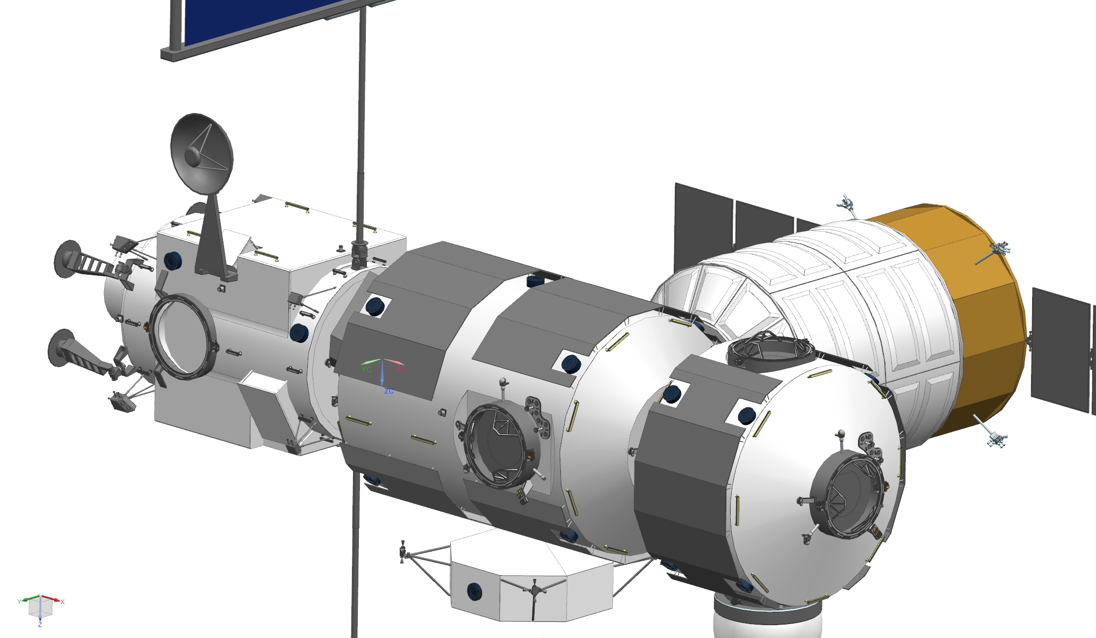
Gateway External
Nominal Ops System Characteristics
(AREx Mark 2)
0.6m parabolic dish or flat plate antenna
  Mast Mounted LNB; power amplifier (PA trade on-going)
  Prefer dish mounting on PPE or HALO
  Assume: 2m mount
  Employ Sierra Nevada 2-axis pointing system (Required accuracy ~1 degree)
Downlink: X-band 10.45-10.5 GHz
Uplink: S-Band 2.4-2.45 GHz, C-Band 5.65-5.67 GHz (alternative)
Modulation: DVB-S2 (supports Voice, Data, SSTV, Video)
Gateway External Resources: 100W, TT-GigE Data, vehicle attitude and Earth pointing vector
0.6 m dish
2 m Mast
w/ Az-El
Gimbal
System

Slide 94

Gateway External
Contingency Ops system Characteristics
(AREx Mark 2)
2 omni-directional 70 cm (435-438 MHz) ¼ wave Vertical Antennas
Mounted on opposite sides of module
Option: Employ EVA antennas
Uplink/Downlink: 70 cm band 435-438 MHz
Modulations: Various weak signal communications modes (e.g. JT65, FT8, Olivia MFSK-16, BPSK-31)
Gateway External Resources: 100W, TT-GigE Data (optional)
Note: Contingency and nominal downlink transmitters will not operate at the same time

Slide 95
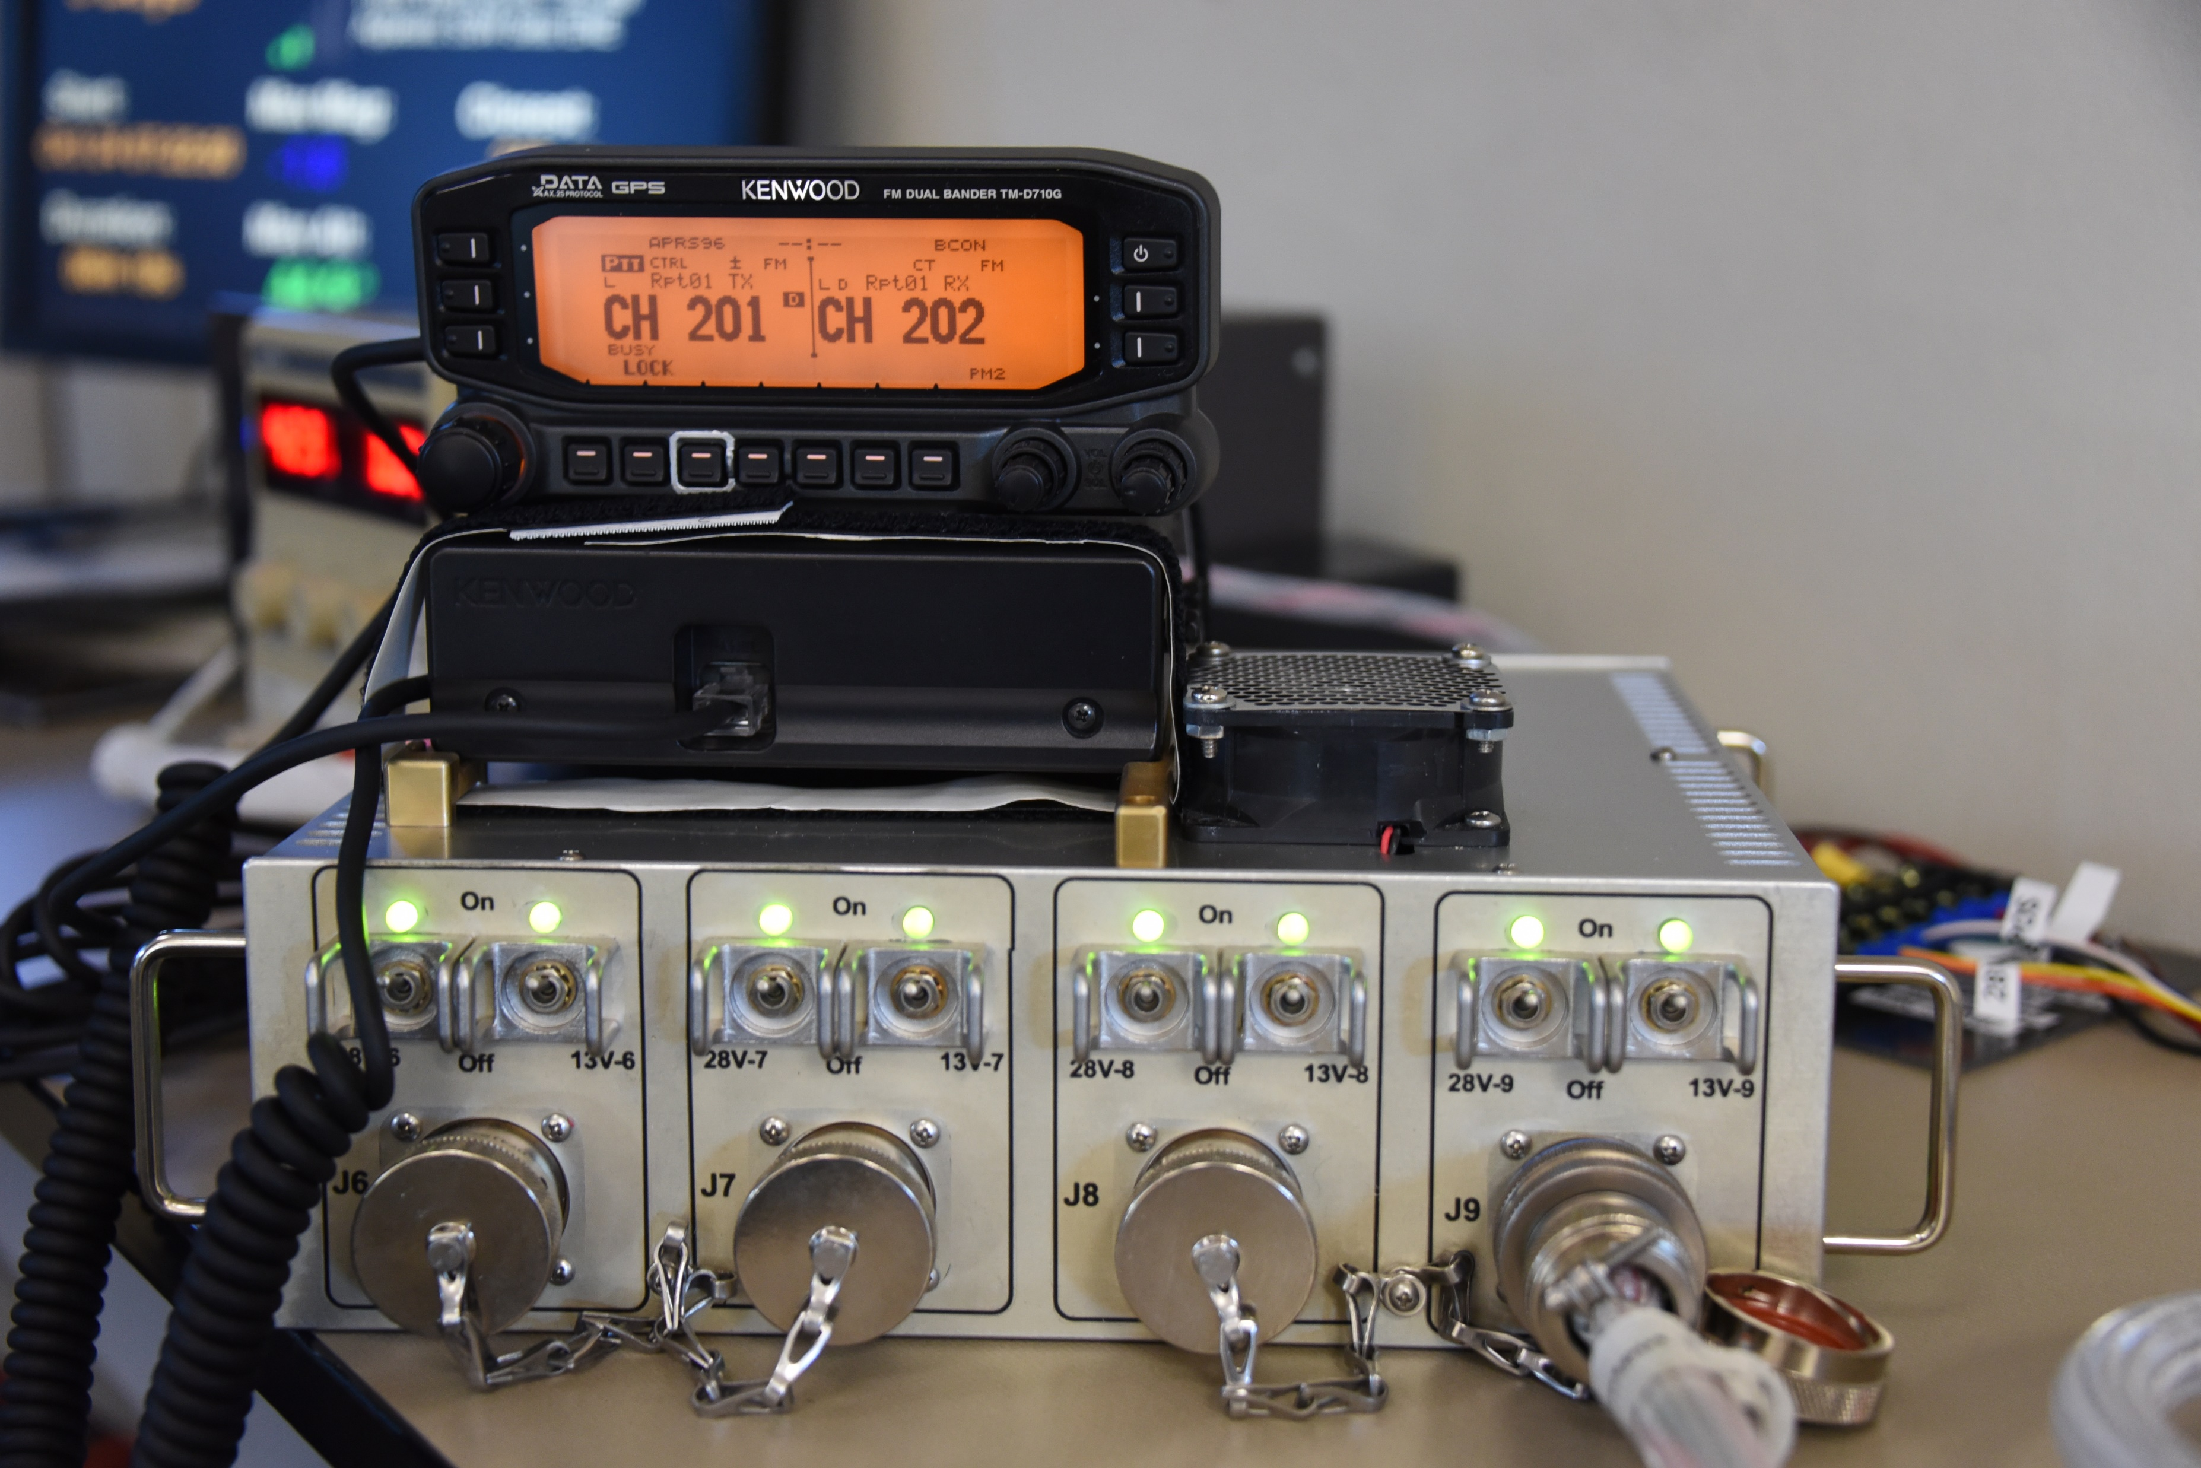
Gateway Internal
(AREx Mark 2)
Volume: 36 cm x 18 cm x 20 cm (Radio System), 28 cm x 22 cm x 10 cm (Power Supply)
Multi-voltage power supply, 300 W max pwr
Radio transceiver system, 100 W max TX (internal or external pwr amp)
Normal Ops Downlink: X-band 10.45-10.5 GHz
Contingency Ops Up/Downlink: 70 cm band 435-438 MHz
Normal Ops Uplink: S-Band 2.4-2.45 GHz
Normal Ops Uplink alternative: C-Band 5.65-5.67 GHz
Normal Ops Modulation: DVB-S2 (supports Voice, Data, SSTV, Video)
Contingency Ops Modulation: Various weak signal communications modes (e.g. JT65, FT8, Olivia MFSK-16, BPSK-31)
AREx Experiment/engagement interface (e.g. MarconISSta, video feeds)
Additional Internal Resources: TT-GigE Data

Slide 96

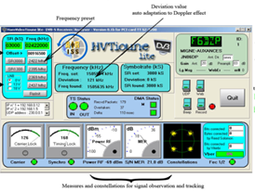
Typical AREx Ground STation
  1 m pointed dish & LNB
  75-100 W transmission power
  Minitoune/CODEC software system
  Weak signal software interface

Slide 97
Gateway interfaces
RF Feedthroughs (AREx Mark 2)
RF Feedthroughs desired: 1 or 3
  1 feedthrough case—only if all antennas on one module
    Use diplexer to split microwave signals from UHF
    Use UHF splitter to distribute signals to 2 UHF omni antennas
  3 feedthrough case—antennas on separate Gateway modules
    2 feedthroughs for UHF and 1 feedthrough for microwave

Slide 98
Development Roles (Top Level)
Mechanical Systems
Electrical & RF Systems
Analyses and Algorithms
Software
Ground station
Communication and Outreach
Space Agency Safety Certification
Space Agency Engineering Requirement Verification
ITAR/EAR99 Compliance

Slide 99
Development Roles
(1/4)
Mechanical Systems
  Mechanical Box design
  Antenna/Feed Design
  Thermal Design
  Camera system
  Mechanical Interfaces
  Launch mounts
  Pointing System (electro-mechanical) Procurement
  Drawings/Labeling/Configuration Control
  Test and Verification
  Safety Hazards
  Engineering Requirements

Slide 100
Development Roles
(2/4)
Electrical & RF Systems
  Power Supply
  Software Defined Radio/Signal Processor
  Command and Data Handling
  RF/Power Amplifier
  Electrical Interfaces
  Radiation/effects
  Test and Verification
  Safety Hazards
  Engineering Requirements

Slide 101
Development Roles
(3/4)
Analyses and Algorithms
  Link Budget
  ACM/VCM (Adaptive Coding Modulation/Variable Coding Modulation Management)
  Earth visibility
  Moon visibility
  Pointing system Algorithms
Software
  Operating System
  Command and Data Handling
  Pointing System
  SDR/FPGA VHDL Code
  Test and Verification
  Safety Hazards
  Engineering Requirements

Slide 102
Development Roles
(4/4)
Ground station
  Prototype development
  Software
  Ground station design communication
Telemetry Storage (e.g. Fox Warehouse/BATC Server)
School Contact and Command Security
Communication and Outreach
Space Agency Safety Certification
Space Agency Engineering Requirement Verification
ITAR/EAR99 Compliance

Slide 103
AREx Gateway
Proposed Lifecycle Milestone Reviews
Tailored from NASA NPR 7120.5E
Project Life Cycle Phases
Concept/Formulation
Phase A
Preliminary Design
Phase B
Final Design & Fabrication
Phase C
Integration, Test & Launch
Phase D
Launch
MCR/SRR
Phase 0 Safety
PDR
Phase I Safety
CDR
Phase II Safety
Phase III Safety
Acronyms
CDR—Critical Design Review
MCR—Mission Concept Review
PDR—Preliminary Design Review
SRR—System Requirements Review
Plan: MCR/SRR to be held in August 2020

Slide 104
Project Phase A: Concept/Formulation
Purpose
To determine the feasibility and desirability of a new system and establish an initial baseline compatibility. Develop
final mission concept
system-level requirements
needed system technology developments, and
project technical management plans
Phase A Reviews:
MCR: Mission Concept Review
SRR: System Requirements Review

Slide 105
Project Phase A: Concept/Formulation
MCR/SRR Products/Activities Tailored to AREx/Gateway
Develop Initial Technical Baseline/Mission architecture
Concept documentation
Mission/spacecraft architectures
Project-level requirements, including internal and external interfaces and system software functionality
Allocate system requirements to functions and to next lower level
Identify technology challenges
Operations concept
Technology readiness assessment documentation
Engineering development assessment documentation
Heritage assessment documentation Develop breadboards, engineering units, previous system examples or models, identify and reduce high risk concepts
Demonstrate that credible, feasible design(s) exist
Perform and archive trade studies
Initiate studies on human systems interactions
Perform technical (project) management
  Provide technical cost estimate and range and develop system-level cost-effectiveness model
  Identify top risks, risk mitigation plans, and associated resources
  Define the WBS (Work Breakdown Structure)
  Develop SOWs (statements of work)
  Schedule (project-level)
  Acquire systems engineering tools and models
  Establish technical team needs
  Cost estimate (preliminary range)

Slide 106
MCR/SRR Success (Exit) Criteria
Mission objectives clearly defined and stated and are unambiguous and internally consistent
The selected concept(s) satisfactorily meets the stakeholder expectations.
Top-level mission and education requirements definition is complete, interfaces with external entities and between major internal elements have been defined.
Requirements definition is complete with respect to top-level mission and science requirements, and interfaces with external entities and between major internal elements have been defined.
The mission is feasible. A concept has been identified that is technically and logistically feasible. A rough cost estimate is within an acceptable cost range.
The need for the mission has been clearly identified.
The cost and schedule estimates are credible and sufficient resources can be made are available for project formulation.
TBD and TBR items are clearly identified with acceptable plans and schedule for their disposition.
Alternative concepts have adequately considered the use of existing assets or products that could satisfy the mission or parts of the mission.
Risk and mitigation strategies have been identified and technically assessed; viable mitigation strategies defined.
Concurrence by the NASA JSC spectrum manager that RF needs have been properly identified and addressed.

